Slide 1
2023 Supplier Conference
August 24, 2023

Slide 2
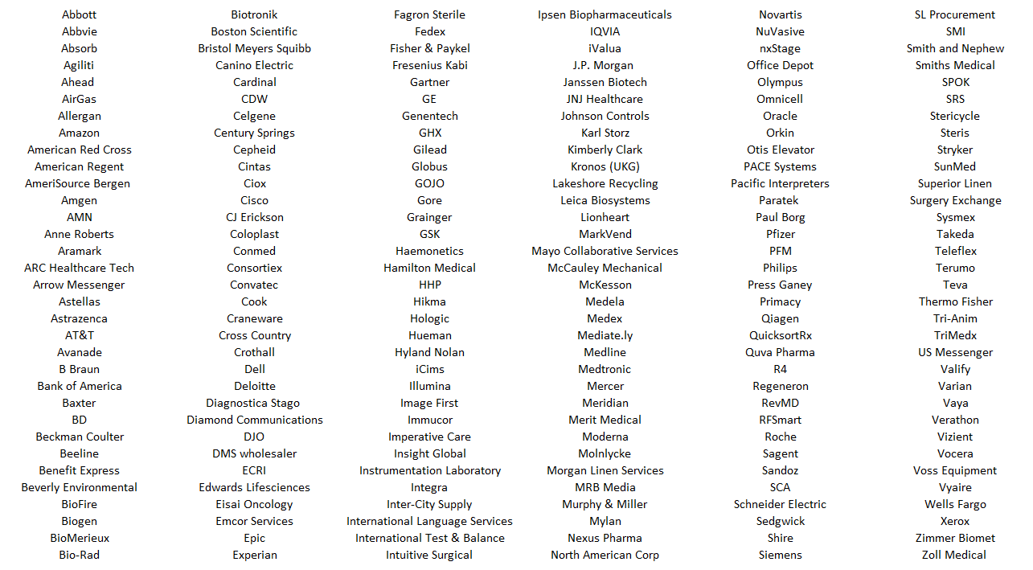
Attendee List
Wifi: UChicago Guest Username: 08210827@uchicago.edu Pass: jxukd

Slide 3
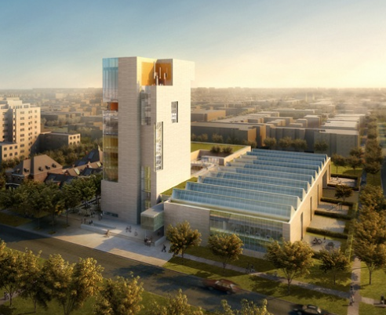
Housekeeping
The Reva and David Logan Center For The Arts
Housekeeping Items
Masking Optional
Restrooms
Exits
Microphones
WIFI: UChicago Guest
User name: 08210827@uchicago.edu
Password: jxukd
How to access slides:
www.uchicagomedicine.org/about-us/supply-chain
Quick Links → 2023 Supplier Conference.

Slide 4
10th Annual UCM Supplier Conference
Purpose:
  Orient key supplier leadership to UCM critical business objectives, expectations, and distinct business practices.
  Update on progress and changes from last year’s conference.
  In order to ….
  Engage suppliers to work continually, passionately and collaboratively to deliver needed improvements and value to our patients.
Format:
Presentation with Q&A opportunities

Slide 5
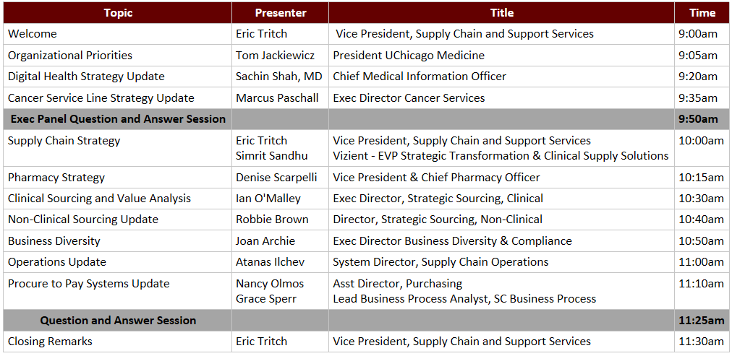
Agenda

Slide 6
UCM: Health System at a Glance
*Not including UCM/Advent JV sites
FACILITIES
1,296
10
Ambulatory
Care Facilities
4
Inpatient Facilities
Licensed Beds
Chicago: Duchossois Center for
Advanced Care, River East, South Loop
Orland Park
Harvey: Professional Office Building
Calumet City, Flossmoor and Tinley Park: Family Care Centers
Crestwood and South Holland: Care Centers
Also: Comprehensive Cancer Center at Silver Cross,
Care Network/off-site clinics in Chicago and suburbs
Center for Care and Discovery
Bernard M. Mitchell Hospital
Comer Children’s Hospital
Ingalls Memorial Hospital
821 Med Surg
171 ICU
67 OB-GYN
60 General Pediatrics
53 NICU
78 Acute Mental Illness
46 Rehabilitation
48
Operating Rooms
PEOPLE FINANCIALS VOLUME
11,857
$2.79B Operating Revenue
$2.33B Net Patient Service Revenue
1,220,906 Ambulatory Visits
45,746 Hospital Admissions
302,100 Hospital Patient Days
31,791 Surgical Cases
191,391 ED Visits
3,097 Births
5,233 Trauma Activations
Employees
Including:
1,400 Physicians
3,328 Nurses
1,010 Residents and Fellows
Notes:
Advent – 4 hospitals, 400 physicians, 96k ED visits

Slide 7
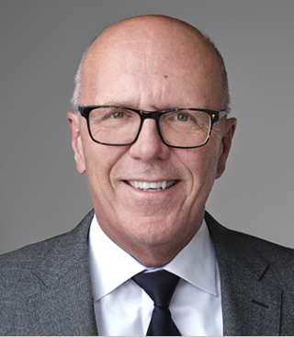
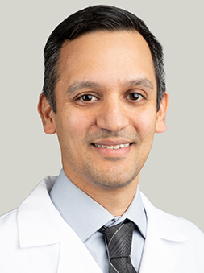
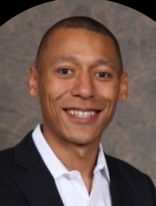
Executive Leadership Update
Tom Jackiewicz
President
UChicago Medicine
Sachin Shah, MD
Chief Medical
Information Officer
Marcus Paschall
Executive Director Cancer Services

Slide 8
Organizational Priorities – Tom Jackiewicz

Slide 9
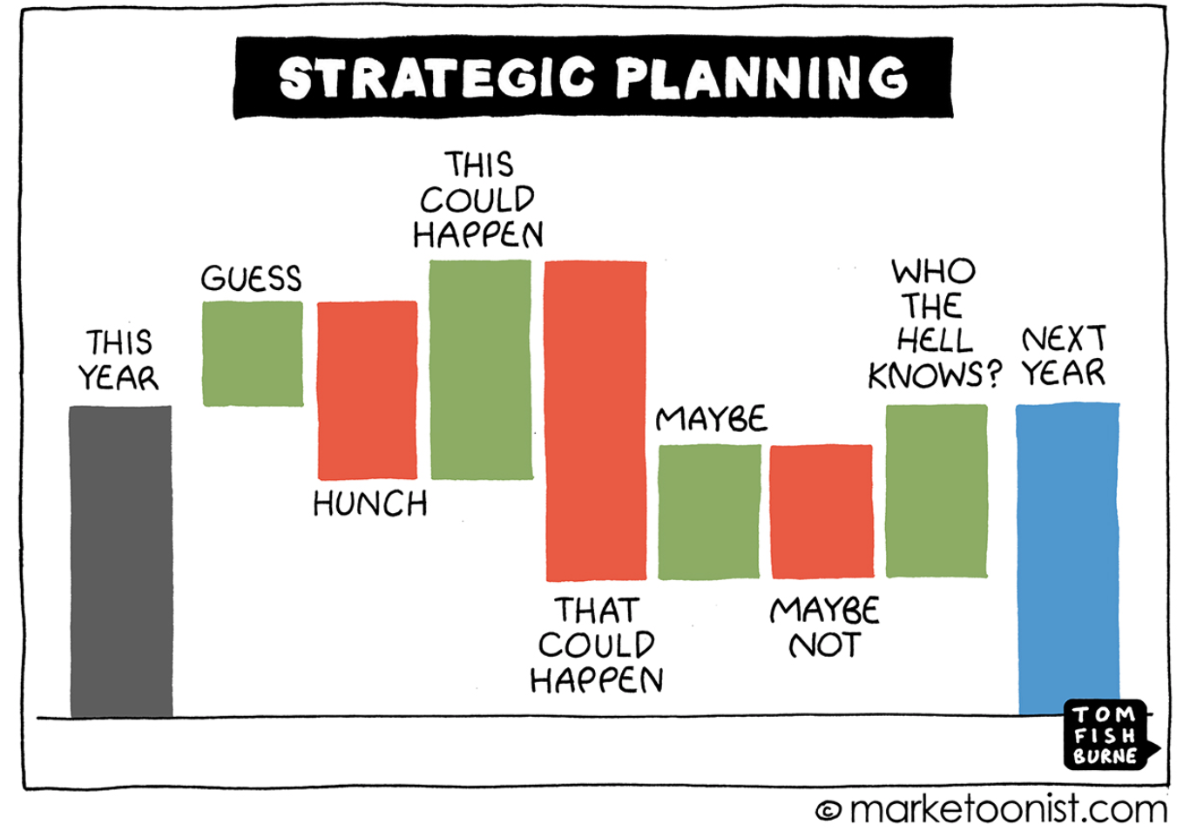
Outlook for U.S Healthcare
Notes:
Hospitals and health systems are facing overwhelming pressure on many fronts.
According to Fitch, 2022 was "the worst operating year ever seen" in the hospital sector, with 2023 set to be a "make-or-break year" for many.
UCM is not immune to these financial pressures and uncertainties – they are having an impact and we are factoring them into all decision making.

Slide 10


Growth, especially among ambulatory care services as well as faster growth on the research side
Transformation to serve the needs of the healthcare marketplace of the future
Excellence in everything we do, validated by national rankings; clinical success is our lifeblood
One

Slide 11
UChicago Medicine Vision 2025
Excel
Grow
in Patient and Clinician Experience
Signature Specialty Programs
Deliver
Expand
High-quality, Cost-effective Care
Our Health System Network
Enhance
the Health of Our Local Community
Notes:
As we have worked on these initiatives, the financial headwinds that all hospital and health systems are facing must be considered.
Labor and related expenses have grown much faster than our reimbursements over the last 18 months.
Our new cancer center, which I’ll talk more about in a few minutes, will require that we carefully watch our expenses and increase revenue in the future.
Our margins, while modestly in the black, have been compressed. In the coming years, we will need to do more with less, and we will need all of our suppliers to help.

Slide 12
UCM Vision 2025
Ranked among the best in the country in 10 specialties by USNWR; one of just 24 hospitals in the country to have 10 or more specialties ranked in the top 50 and the top cancer care program in Illinois
Building Chicago’s first freestanding comprehensive cancer care and research center ($815M, 575,000-square-foot facility with future expansion opportunities)
AMITA-UCM Cancer partnership
Building Crown Point Cancer Center and LOI to acquire oncology practice
Clinical neurosciences relationship with Silver Cross
Expanding relationship with Advocate NorthShore Pediatric Partners – goal of becoming a top 10 children’s hospital
Expanding behavioral health, obstetrics and other services at UChicago Medicine Ingalls Memorial to better meet community needs
Grow
Signature Specialty Programs
Our Health System Network
Enhance
the Health of Our Local Community

Slide 13
UCM Vision 2025
Western suburbs market presence through AdventHealth joint venture; four hospitals in Bolingbrook, Glendale Heights, Hinsdale and La Grange along with a network of nearly 50 physicians’ offices and outpatient locations
Northwest Indiana multispecialty center and micro-hospital construction
Building a Medicare Advantage strategy
New PCPs added to Care Network
Two new Care Network locations in Dearborn Station and Homewood
Developing a post-acute strategy
Expand
Our Health System Network
the Health of Our Local Community

Slide 14
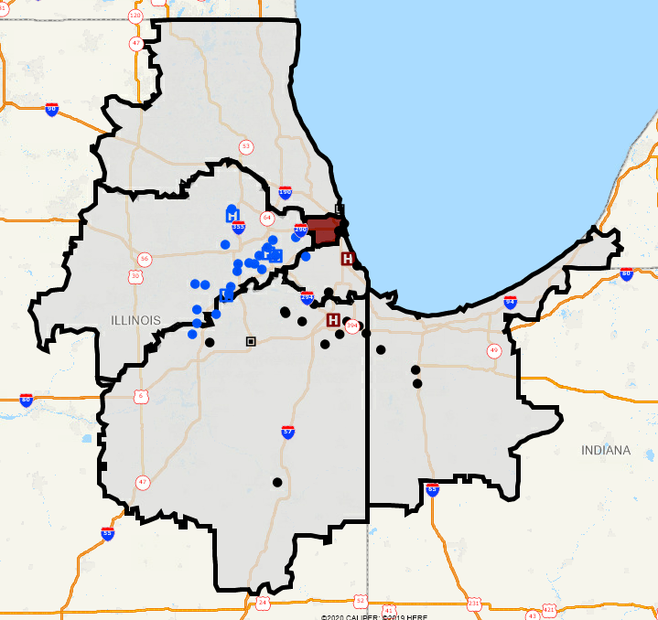
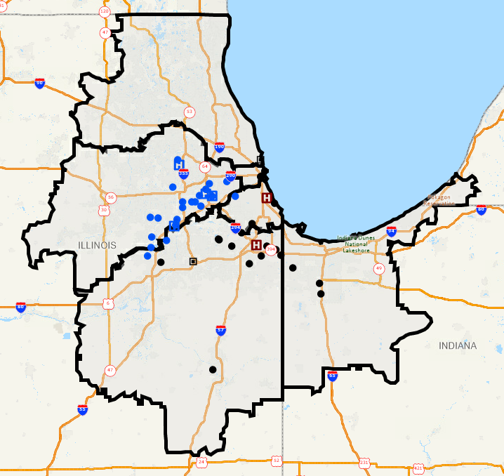
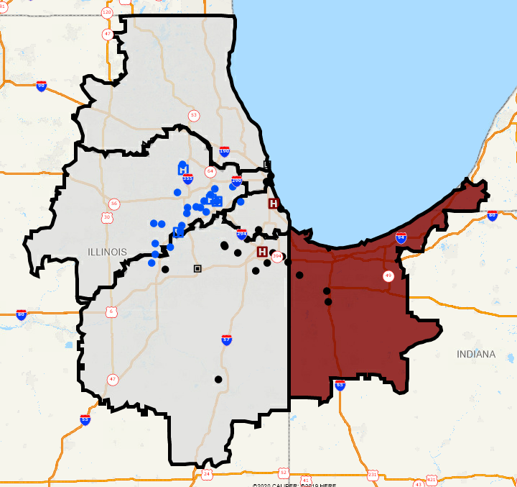
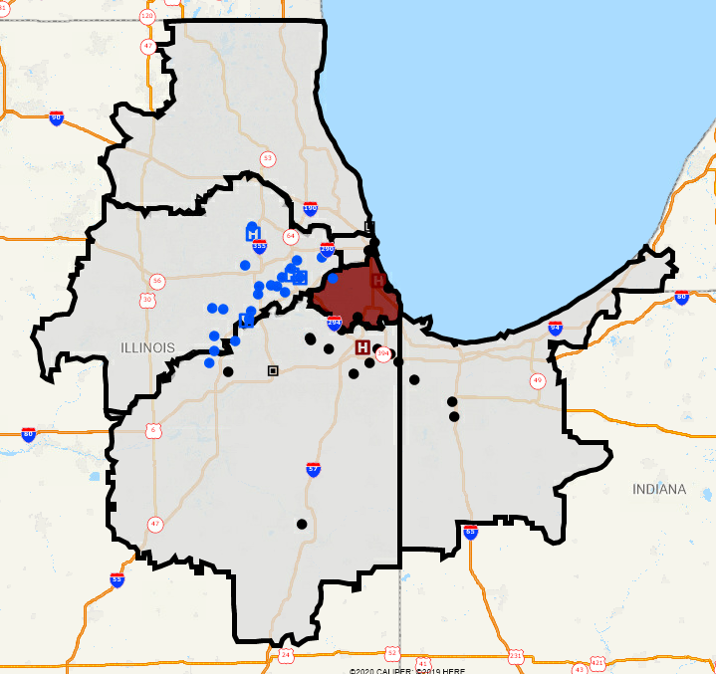
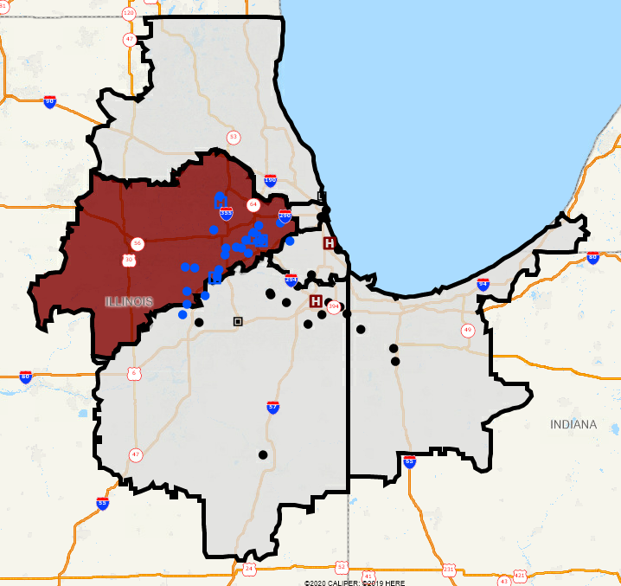
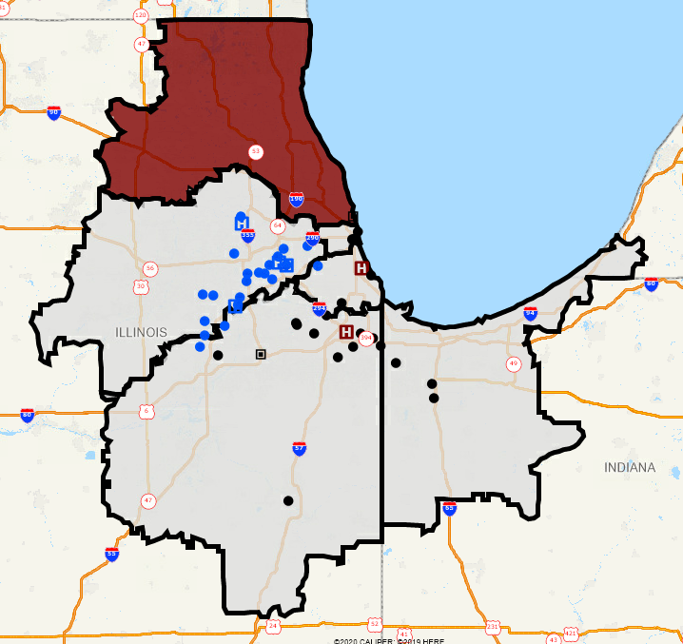
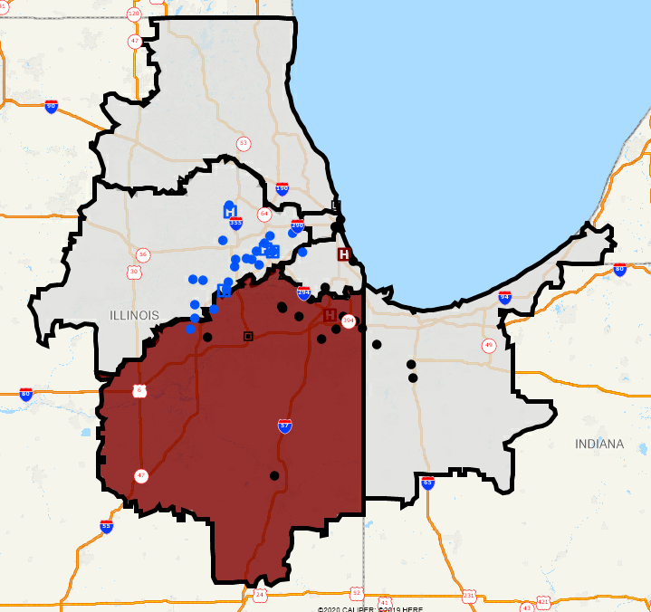


Network Development
We are growing across markets in our primary and secondary service areas as part of Vision 2025
Downtown
West Side & Western Suburbs
North Side & North / Northwest Suburbs
South Side
Northwest Indiana & Southwest Michigan
South & Southwest Suburbs
Legend
14
UCM
Cancer JV
Note: UCM OP locations inclusive of Planned Crown Point Facility (target opening Spring 2024)
IP
AH
OP
Notes:
Animation on slide showing different markets

Slide 15
UCM Vision 2025
Invested $686.2 in community benefits in FY22
Southside Healthy Community Organization officially launches
Approximately 3,000 patients and families cared for each year by UCM Violence Recovery Program; national model
UCM serves as co-lead with Senator Durbin’s office on Chicago HEAL
First graduating class of UChicago Medicine's Evolve and Rise Higher Programs
Enhance
Signature Specialty Programs
Excel
Grow
the Health of Our Local Community
in Patient and Clinician Experience
Our Health System Network
Expand
High-quality, Cost-effective Care
Enhance
the Health of Our Local Community

Slide 16
UCM Vision 2025
Grow
23rd consecutive “A” rating from Leapfrog Group
Top performer in state for wellness visits among Medicare Advantage patients
IT investments/Project SOAR
Building a clinically integrated network
Same day appointment access and patient-centric hours with Care Network
Post-discharge phone calls lower readmission rates significantly
Initiatives to improve capacity/access and advance clinical pathways
Deliver
Expand
Signature Specialty Programs
High-quality, Cost-effective Care
Our Health System Network
the Health of Our Local Community

Slide 17
Impact of initiatives implemented across FY23 translating to improved LOS performance compared to previous Fiscal Years
As OF AUGUST 20, 2023
Overall average length of stay at UCMC, days
FY22 LOS
7.5
FY23 LOS
FY24 LOS
7.3
7.0
6.5
6.0
6.0
5.5
JUL
AUG
SEP
OCT
NOV
DEC
JAN
FEB
MAR
APR
MAY
JUN
UCMC reached its best performance on average LOS at the start of FY24, with July closing out at 5.96 days.
While performance has increased in August, overall LOS continues to trend lower than start of FY22 an FY23.

Slide 18
UCM Vision 2025
New Chief Wellness and Vitality Officer
New Chief Experience Officer
New Chief Marketing Officer
Recognized as the 6th most inclusive hospital in the country by the Lown Institute
In FY23:
Black, Indigenous and People of Color (BIPOC) representation in senior leadership increased to 26%
37% of UCM leadership promotions went to BIPOC
32% of total UCM leadership hires went to BIPOC
Excel
Grow
Signature Specialty Programs
in Patient and Clinician Experience
Our Health System Network
Deliver
Expand
High-quality, Cost-effective Care
Enhance
the Health of Our Local Community

Slide 19
Digital Health Strategy Update – Sachin Shah, MD

Slide 20

Digital Transformation
Integrate digital tools and technologies to enable innovative models of care delivery designed to
Enhance patient care
Streamline operations
Optimize outcomes

Slide 21

What is Digital Transformation?
Use of digital tools to:
Improve the patient experience → improve clinical outcomes
Risk stratify → improve care, reduce health disparities
Forge a more continuous relationship with our patients → improve access
Improve processes of care delivery →
more consistent, higher value care
Population level management of care gaps →
better preventive health and chronic disease mgmt
Add digital tools & reorganize care teams →
innovative new models of care delivery

Slide 22


Clinical Areas of Focus
Virtual Models of Care Delivery
  Improve access
  Lower barriers
  More cost-effective
Remote Patient Monitoring
  More continuous relationship
  Better chronic disease management
  Optimize team based care
Artificial Intelligence and Analytics
  Improve diagnosis & predict outcomes
  Higher efficiency care delivery
  Find patterns and risk stratify patients

Slide 23




Virtual Models of Care Delivery
- Lowest complexity
medical advice
- Routine preventive health
- Lower complexity urgent care
- Stable chronic disease management
- Higher complexity care urgent care
- Active chronic disease management
- Highest complexity care
- Procedures
Lower acuity / lower complexity / stable
Higher acuity / higher complexity / active
Asynchronous / virtual
RPM / H@H
Synchronous / in person
CHW / MA / LPN / RN
APP
Physician
Notes:
Risk stratify patient care needs based on acuity / complexity / stability and offer different options to patients
Those lower risk / lower complexity patients who are willing and able to self-manage with asynchronous and virtual options can
Free up some resources to better support those who are higher acuity/complexity and/or cannot or do not want to self-manage
Medical complexity (risk of acute care utilization)
Health literacy
Digital literacy
Engagement/activation
Ability to self-manage

Slide 24

In order to better address a major chronic disease with significant associated morbidity and mortality that disproportionately impacts patients of color, I have piloted a remote patient monitoring (RPM) program for patients with uncontrolled hypertension, using digital activation to improve control and reduce health disparities.
RPM Hypertension

Slide 25

RPM HTN Team & Resources
People (centralized team)
Digital Navigator (MA float pool)
Physician informatics (2)
Population health RNs (3-5)
Ambulatory pharmacists (1-2)
Resources (requiring funding)
Bluetooth enabled blood pressure cuffs (~$60/ea)
Reporting & analytics (CD&A, medical informatics)

Slide 26













PCG HTN RPM Management Workflow
1
2
3
4
Patient takes vital measurements and surveys at home
Real time alert to RPM pool for same or next business day f/u for higher risk BP values
Weekly digest of BPs + med adherence data reviewed by UCM Pop Health RN team
Protocol driven BP med titration via telephone outreach encounters
!

Slide 27
Overview of Pilot Data
Go-Live: May 2022
At 12 months (May 2023):
  82% of enrolled patients identify as Black
  >6200 weekly outreaches (telephone calls/note to patients)
  >1000 RPM Episodes, ~1000 unique patients
    Usually 125-150 active at a time
  >26,500 Blood Pressures associated with the program
65% of participants have their last BP captured as controlled within a median of 8-10 weeks

Slide 28
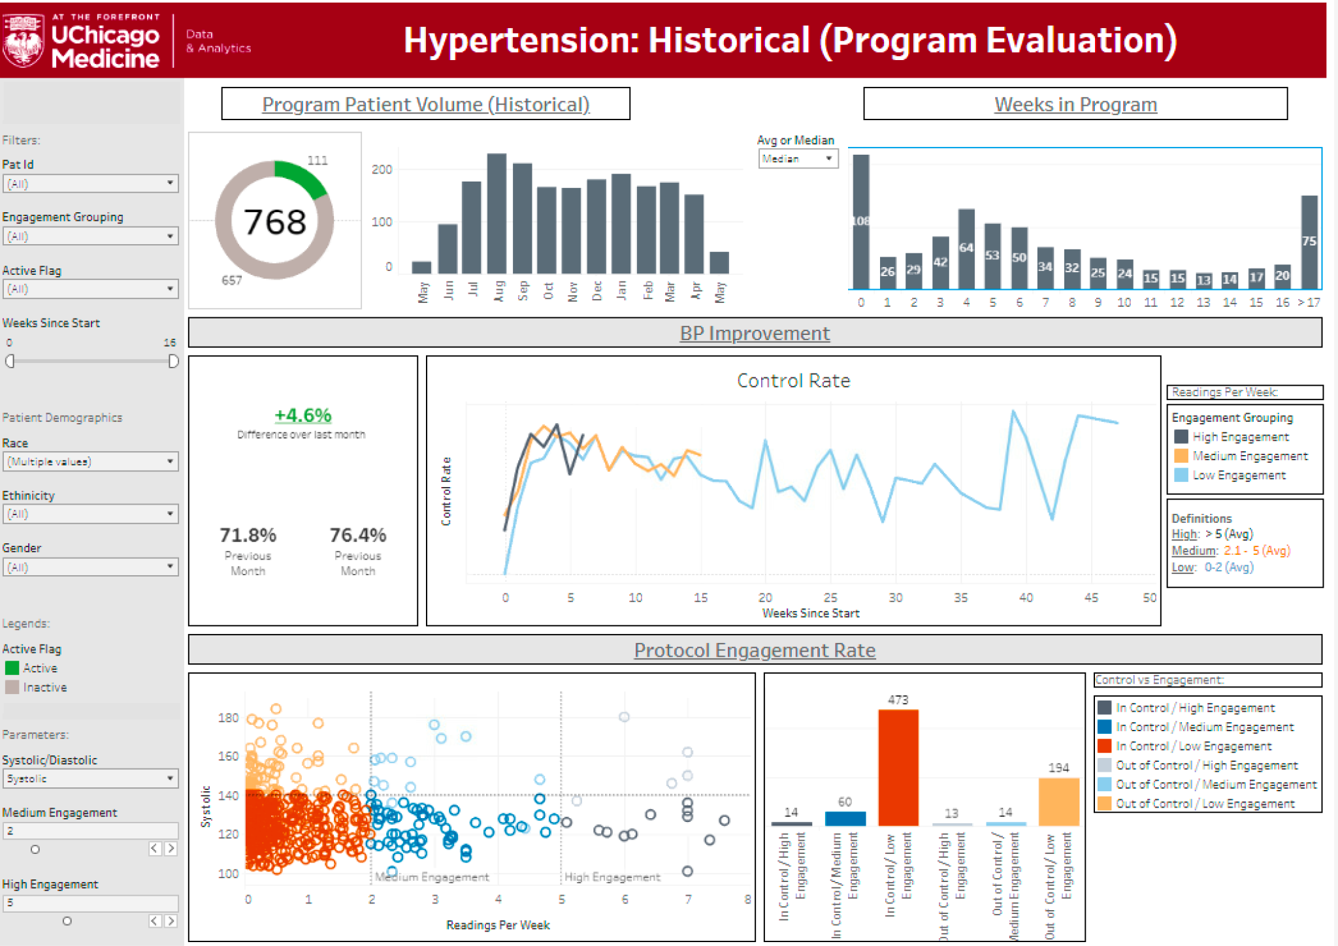

RPM HTN: Next Steps
Expand to Nephrology, Cardiology, Neurology, Ob, and more UCM Primary Care practices
Expand to the ED to help improve uncontrolled HTN
Deploy Chatbot app for ongoing monitoring and coaching post-graduation (and PRN re-escalation)
Expand Tableau-based data visualization

Slide 29



  Transparency
  Engagement
  Agency
  Virtual care options
  De-coupled care
  Reorganized care teams
  Wellness & chronic disease registries
  Care gaps
  Decision support
  Panel / population management
  Access to technology
  Digital literacy & navigation
  Broadband access
  UI updates
  Advocacy & policy
Patient Experience
Population Management
Digital Health Equity
Risk Stratification
Quality Dashboards & Reporting
Equity Lens
Analytics

Slide 30
Patient Experience: Agency
Self-scheduling (cancel, reschedule, auto-waitlist)
Appointment reminders, eCheck-in, auto-arrival
Refill requests, patient generated health data
Review & update med lists, history, vaccine records
View and pay statements
Patient reported outcome measures (PROMs)
Notes:
A form of automation – reducing the need for human care team capital to perform many tasks

Slide 31

Digital Front Door
First point of contact for patients – portal+
24/7 access, optimized patient experience
Appointment management
Support, guidance (automated and human)
Improve scheduling access by sharing capacity
On demand virtual visits (urgent care)
Triage to appropriate type of care
(asynchronous vs synchronous; virtual vs in person)
Deploy digital therapeutics
Pay bills, fill out pre/post-visit questionnaires
Reduce fragmentation of care
Promote convenience, self-efficacy
Build loyalty

Slide 32
Allocation of limited resources
In person care (access, appts)
Call center, scheduling (human capital)
MA/LPN/RN care teams (routine care + triage)
Care coordination teams (higher intensity care)
Population health nurses (outreach)
Community health workers (support)
Notes:
Medical complexity (risk of acute care utilization)
Health literacy
Digital literacy
Engagement/activation
Ability to self-manage

Slide 33
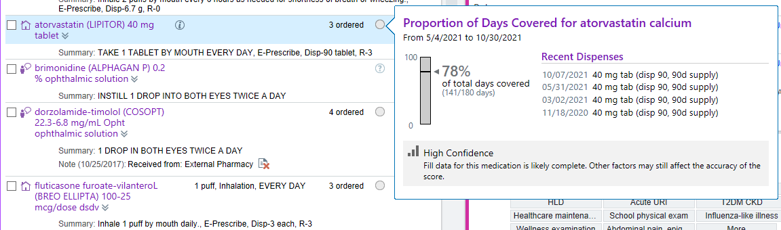
Analytics: Medication Adherence
Notes:
Uncontrolled adherent vs uncontrolled non-adherent
Controlled adherent vs controlled non-adherent

Slide 34
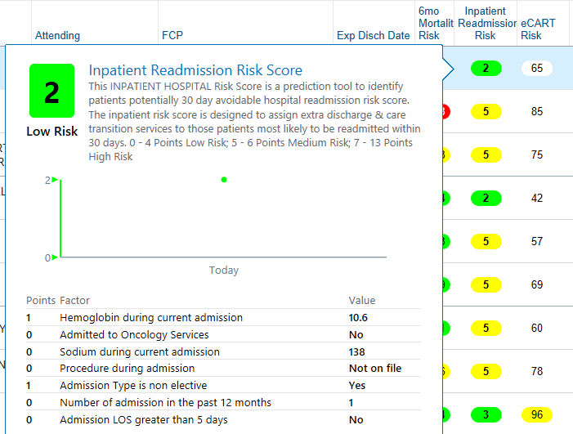
Predictive Analytics: 30 day Readmission Risk
Notes:
Prioritizing TCM visits and care coordination

Slide 35
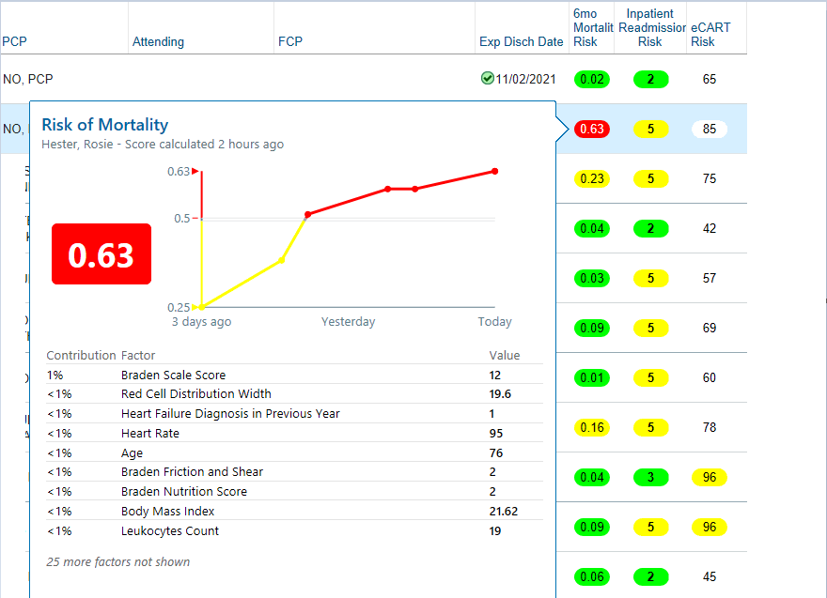
Predictive Analytics: 6 month mortality risk
Notes:
Target for highest priority ACP discussions and documentation

Slide 36


Generative AI
Ambient transcription
Dragon ambient experience (DAX)
Abridge
ScribeAmerica (Speke)
Patient portal medical advice requests and patient education
Answering questions about conditions
Coaching, translation, support, guidance, reminders
Clinical Summaries
Complex patients referred for tertiary/quarternary care (2nd and 3rd opinions)
Summarize long, complicated hospital courses
Concise overview for specialty colleagues to review when asked a consult question

Slide 37
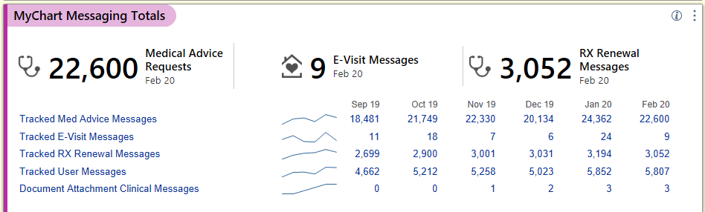
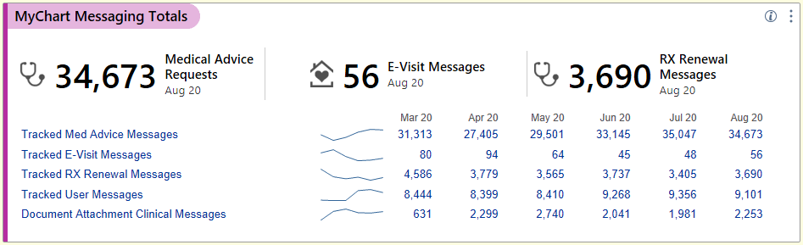

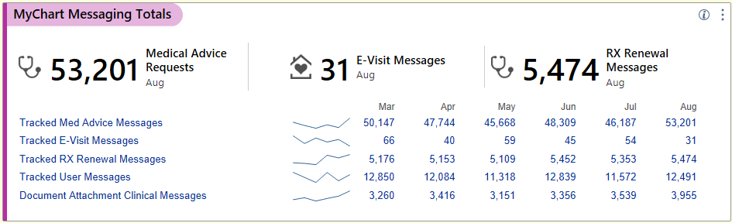
22k/month (Feb 2020)
Pre-pandemic baseline
34k/month (Aug 2020)
+53% from pre-pandemic baseline
42k/month (Feb 2021)
+21% from prior 6 months
+85% from pre-pandemic baseline
53k/month (Aug 2021)
+27% from prior 6 months
+235% from pre-pandemic baseline
Notes:
We’ve seen a surge of patient advice message requests +235%
Uncompensated time, after everything else – the arrow might as well be pointing in the direction of our wellbeing (providers and care teams)
My RN does a remarkable job of working at the top of her license to asynchronously addressing many of the requests, provides great advice for lower complexity issues
A cost-effective way to address low acuity, low complexity care needs while preserving synchronous and in person access for patients with more complex, higher acuity needs
But only if we re-organize our care teams and allocate resources to provide more support for this type of care
It pays off more in a capitated/value based care system than in FFS, especially because it can reduce acute care utilization

Slide 38
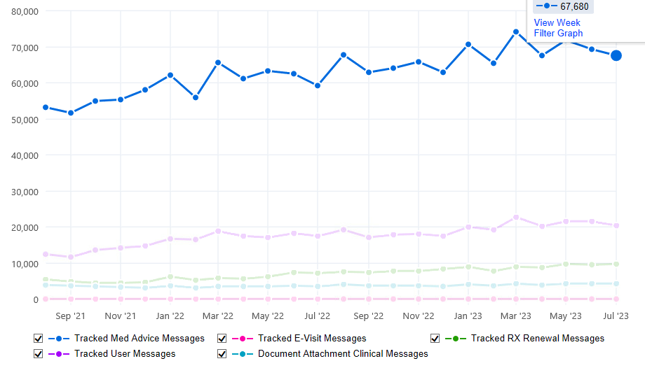


Slide 39
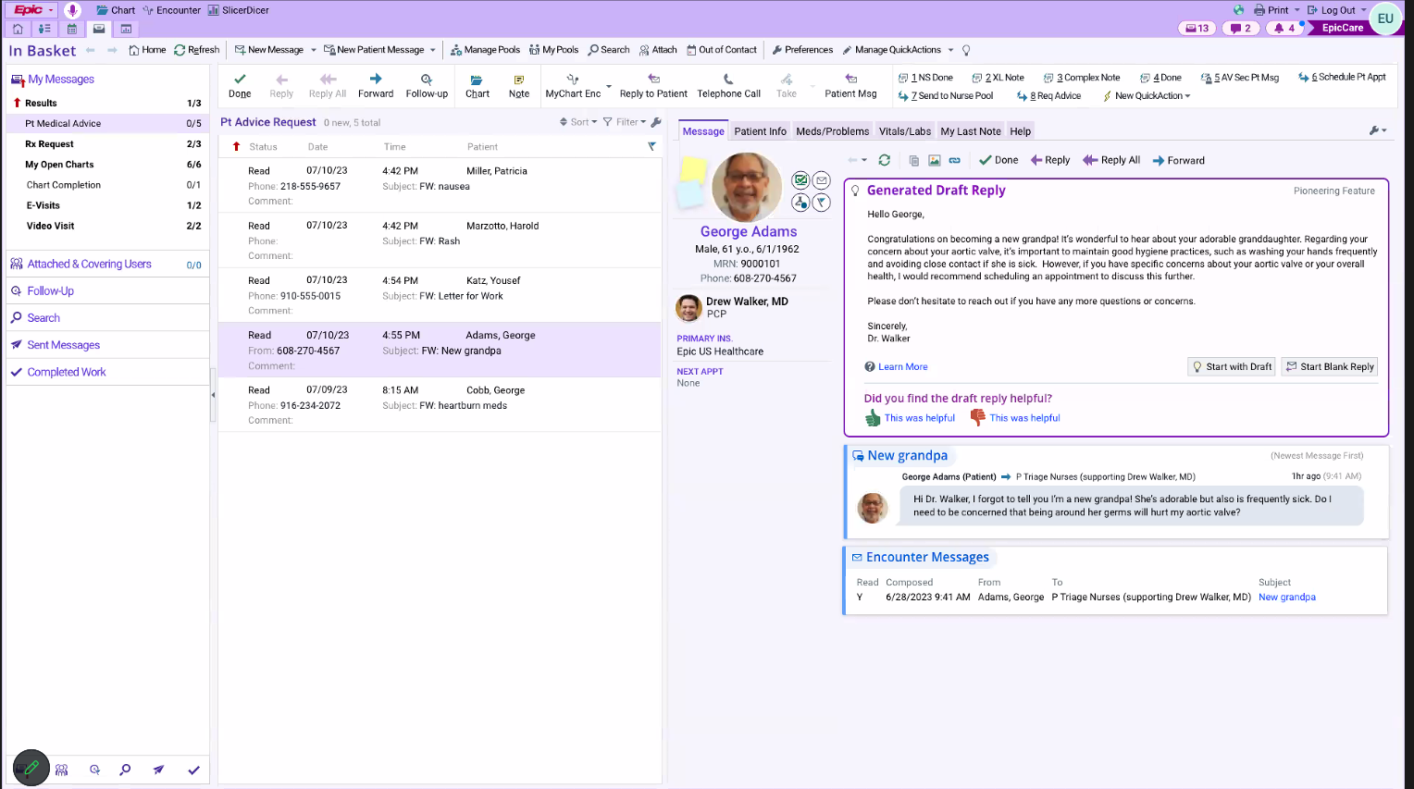

Slide 40

Digital Health Equity
Notes:
Digital health tools have the potential to improve patient engagement and healthcare outcomes, but they are not equitably accessible to all patients.
Black and Hispanic patients are less likely to have access to patient portals, and those who do have access are less likely to use them.

Slide 41

The Digital Divide and Telemedicine
Major barriers to accessing telemedicine
  Absence of technology
  Low digital literacy
  Broadband access
Risk factors
  Older age
  Lower SES
  Minority racial groups
  Lower level of education
  Non-native English speakers
Notes:
Access to digital health options may not be equal for all groups of people in US. Surveys by the Pew Research Center indicate that while 10% of adults in the United States do not use the internet, this percentage increases for people ages 65 and older (27%), people without a high school diploma (29%), people earning less than $30K annually (18%), and racial minority groups including non-Hispanic blacks (15%) and Hispanics (14%)
People earning less than $30K annually have lower rates of access to the devices and networks necessary to use the internet compared to people earning $100K or more annually, including smartphones (71% vs 97%), desktop or laptop computers (54% vs 94%), and home broadband services (56% vs 94%) (5). Regarding race: rates of smartphone ownership are relatively equal among racial groups (82% of white adults, 80% of black adults, 79% of Hispanic adults), but rates of desktop or laptop computer ownership vary (82% of white adults, 58% of black adults, 57% of Hispanic adults), as does access to a broadband connection at home (79% of white adults, 66% of black adults, 61% of Hispanic adults) (6).
American adults >65 years old, who constitute 18% of the American population and are most likely to need chronic disease management, only 55%–60% own a smartphone or have home broadband access

Slide 42
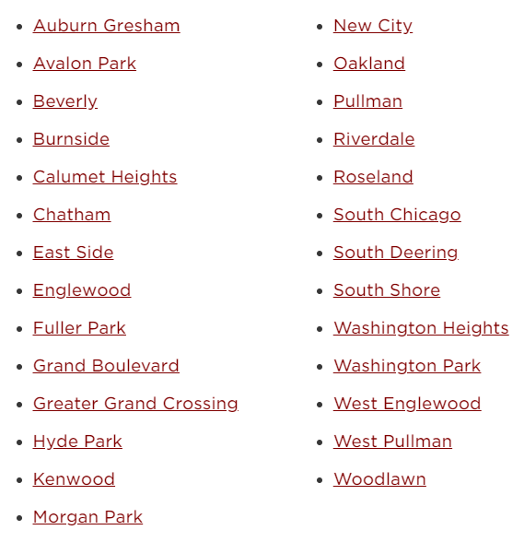
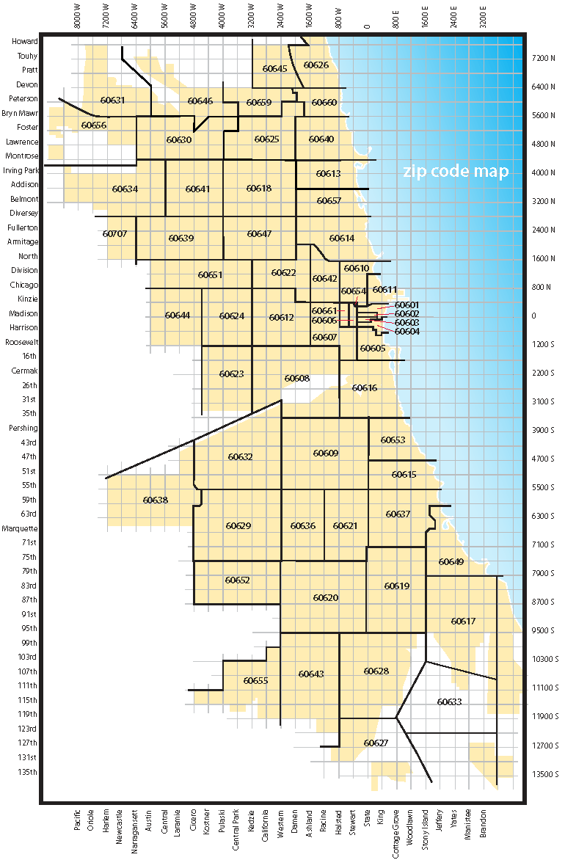
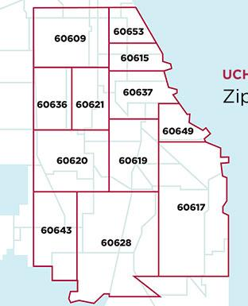
UChicago Medicine
Lack of healthcare infrastructure
Medical and pharmacy deserts
Digital redlining
Notes:
To address these disparities, we need to focus on building trust and engagement with patients from underserved communities.
This includes providing training on how to use digital health tools, making sure that these tools are user-friendly and accessible, and partnering with community organizations to provide support.

Slide 43
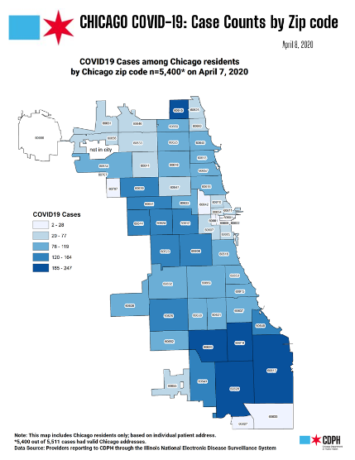
Digital Health Equity
Underserved and digitally excluded patients bear a disproportionate burden of chronic disease and illness
Digital health innovation must not only include, but prioritize these patients
Health systems, vendors, and policy makers must take intentional steps to connect with digitally excluded communities
Innovating exclusively for the most privileged patients will only further widen the digital divide
Notes:
COVID morbidity and mortality
Chronic disease burden
Digital redlining and exclusion
Same map, different captions

Slide 44
Cancer Service Line Strategy – Marcus Paschall

Slide 45
Cancer Service Line at a Glance
OP Encounters
    Cancer Service Line At a Glance
    Cancer Service Line is the most profitable service line at UCM, generating 25% of UCM’s Contribution Margin
    Cancer is ranked at the #1 Cancer Program in the State in USNWR Top Cancer Hospitals; Cancer is UCM’s highest ranking program in USNWR and is #16 overall
    NCI Comprehensive Cancer Center designation
    Ranked #1 in Illinois for Top Doctors by Chicago Magazine and #1 in Illinois for Expert Opinion by USNWR
    American College of Surgeons’ Commission on Cancer has recognized UCM with its top accreditation
    Only hospital in Chicago and one of 22 nationally to receive an A grade in Hospital Safety from the Leapfrog Group in every bi-annual grading cycle
    Select National Recognitions in FY23
    National Comprehensive Cancer Network (NCCN) named the UChicago Medicine Comprehensive Cancer Center as its 33rd Member Institution
    Dr. Kunle Odunsi, Director of the Comprehensive Cancer Center, serves the Principal Investigator of a highly competitive SPORE grant in Ovarian Cancer that was awarded in FY22
    Dr. Everett Vokes completed term President of the American Society of Clinical Oncology (ASCO) Dr. Diane Yamada completed term President of Society of Gynecologic Oncology
Surgical Encounters
New Patient Visits

Slide 46



Cancer Service Line – A Deeper Look
158K
Number of outpatient encounters in FY21
200+
Physicians and scientist researchers
$56M+
Total in peer-reviewed cancer research grants
11
Number of locations across Chicagoland service pts close to home
$435MM
Cancer Service Line revenue in FY22
4,022
Analytic and Non-Analytic cases added to Cancer Registry
1,758
Patients enrolled on clinical trials
424
Publications in peer-reviewed journals
Other Select Highlights
UCM is one of 30 U.S. institutions selected as Lead Academic Participation Sites for NCI’s National Clinical Trials Network
Rapid Growth demonstrated in Theranostic offerings
More than 200 Cellular Therapy (Stem Cell Transplants + Car-T) transplants completed each year
Participation limited to sites with more than 300 open therapeutic trials and that enroll more than 1,000 patients/year

Slide 47
UCM: Health System at a Glance
UCM will be at the forefront of comprehensive cancer care distinguished by eminence in patient-centered care delivery, research, discovery, and training the next generation of cancer leaders
Our UCCCC strategic plan for the Cancer Service Line takes a three-pronged approach to growth.
A
Innovation & Discovery: Expand and Develop Programs of Eminence
Enhance complex care delivery and research capabilities to expand UCM’s differentiation from competitors
Establish new frontiers of innovative cancer therapeutics and discovery by exploiting collaborative University of Chicago environment (e.g. Artificial intelligence, theranostics, nanomedicine, etc.)
Supercharge infrastructure to secure paradigm-shifting transdisciplinary grants (e.g. SPORE)
B
Geographic Expansion: Network Development
Increase access to UCM’s signature offerings at offsite locations - from diagnosis to survivorship
Expand relationships with independent community practices and hospitals to establish a market-leading affiliated network
C
Foundational Growth: Integrate Research and Clinical Patient Care
Integrate cancer clinical and research enterprises to increase collaboration, fuel program development and execution
Establish a free-standing cancer facility to support program growth and create a mission-focused healing space for cancer patients, families and their care teams

Slide 48


Cancer has aggressively expanded its network
NW Community
NW Community
Amita St. Joe’s
Amita St. Joe’s
Streeterville
AH Hinsdale
Silver Cross
Orland Park
Calumet City
2015
Current State
Harvey
Tinley
Flossmoor
Silver Cross
NWI Crown Point
Cancer Center
GYN Onc
Breast Surgery
Carle Hospital (Urbana)
Transplant
Med Onc/IVTH
Thoracic

Slide 49
Planned to open April 29, 2024, the UCM Crown Point development will be our largest facility in NW Indiana. It will provide limited IP care along with a range of ambulatory capabilities and offerings. The site is projected to provide care to ~110,000 patients per year.
NWI – Crown Point Site Program
The facility is130K SF spanning across two levels and includes the following:
Micro-hospital, with an ED (8 beds) and IP unit (8 beds)
Comprehensive Cancer Center to include chemo infusion and medical, radiation and surgical oncology
Imaging center with MRI, CT, PET, X-ray and Ultrasound capabilities
Infusion and Laboratory Services
Mammography and DEXA imaging services
Ambulatory Surgery Center
MOB, with clinics in Cardiology, Digestive Diseases, Neurology and Neurosurgery, Orthopedics, Pediatrics, Transplant Medicine, Women’s Health, Surgical Services and Primary Care
Additional shelled space for exam room expansion on the 2nd floor
On September 1, 2023 UCM will begin operations at four medical oncology office buildings in the Northwest Indiana suburbs and these sites will help drive cancer volume to the larger NWI-Crown Point site.

Slide 50
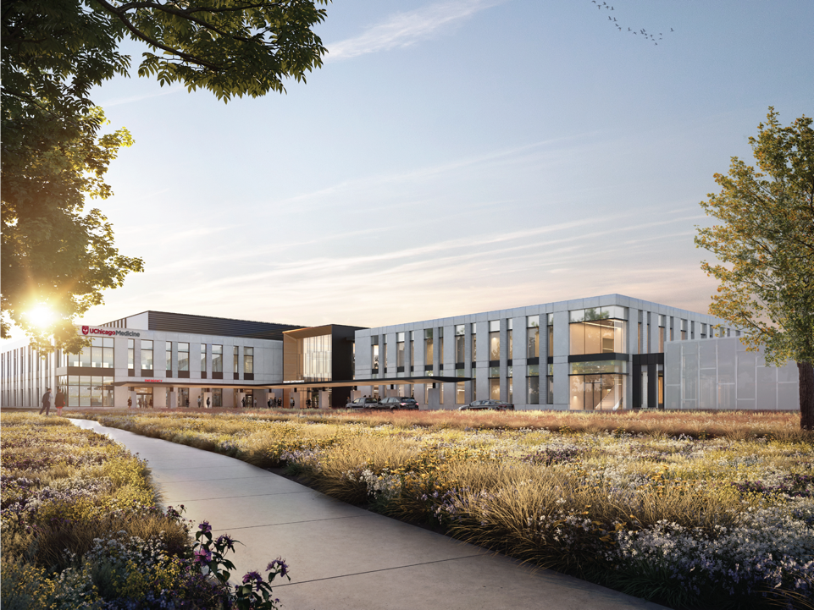

Slide 51
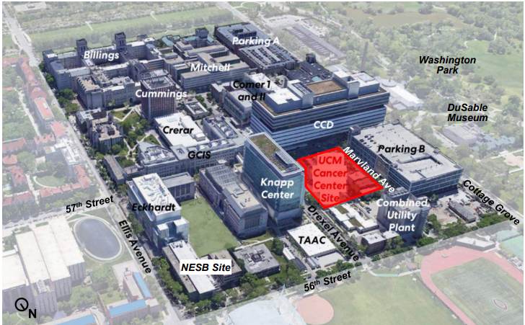
UCM breaks ground on an $800M Cancer Center next month
Building Highlights
First freestanding comprehensive clinical Cancer Center in the Chicago market
Will offer eight floors of world class clinical care in a marquee facility that is a true destination for cancer care, now and in the future.
Will embody a patient and family centric experience, ensuring all services across the continuum of care are co-located, including ambulatory, a full suite of imaging and diagnostic solutions, 80 dedicated cancer beds, and clinical trials units
Will deliver multi-disciplinary, technologically advanced care with access to the newest therapies and treatment innovations which are anchored by pioneering basic & translational research.
Will be where ground-breaking science and efficient, compassionate care meet to provide an unrivaled approach to conquering cancer.

Slide 52
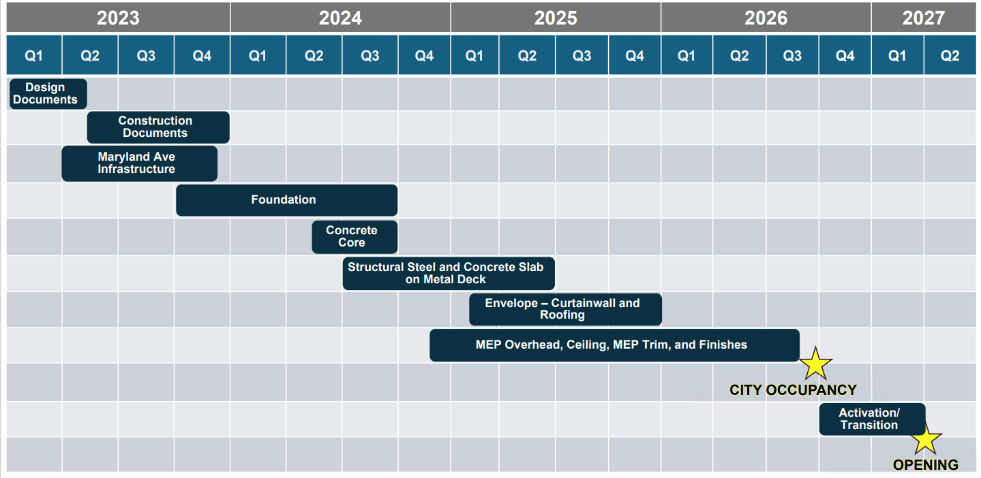
The Hyde Park Cancer Pavilion will open in Spring 2027

Slide 53
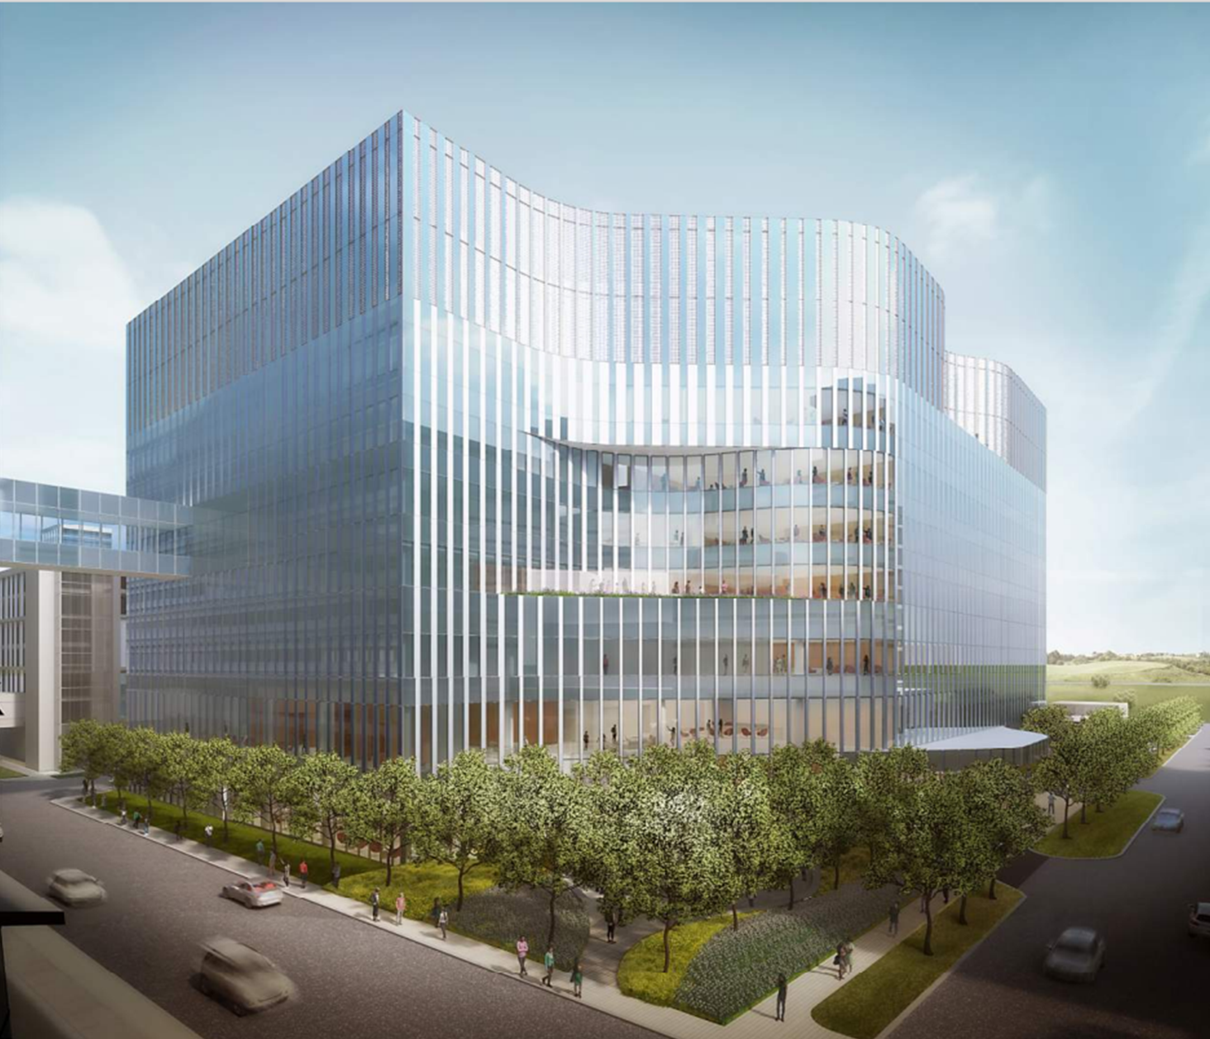
The Hyde Park Cancer Pavilion will open in Spring 2027
Building Highlights
80 Inpatient Beds
96 Outpatient Exam and Consult Rooms
66 Infusion Bays
24/7 Urgent Care Facility
30,000 square feet dedicated to a future Radiation Oncology buildout
Two shelled floors dedicated for future growth opportunities
Dedicated “fusion” space established on each floor to foster collaboration and multi-disciplinary care
Comprehensive radiology suite on the first floor with programming for CT, MRI, Ultrasound, X-ray and more
Dedicated space for an infusion pharmacy with shelled space to allow for growth of Investigational Drug Services Pharmacy

Slide 54
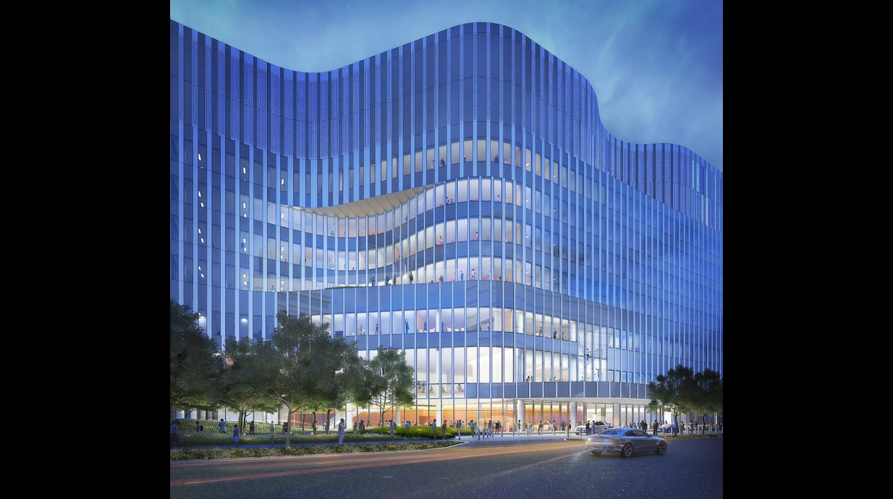
Thank You

Slide 55
Executive Q&A Session
Tom Jackiewicz
President University of Chicago Health System
Sachin Shah, MD
Chief Medical
Information Officer
Marcus Paschall
Executive Director Cancer Services

Slide 56
Eric Tritch
VP Supply Chain & Support Services

Slide 57
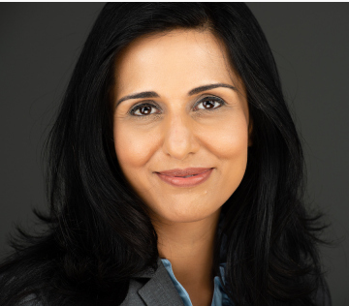
UCM & Vizient Supply Chain Strategy Update
Simrit Sandhu
Vizient – EVP Strategic Transformation & Clinical Supply Solutions
Notes:
Eric – intro Simrit invites onto stage.

Slide 58
UChicago Medicine Vision 2025
Excel
Grow
in Patient and Clinician Experience
Signature Specialty Programs
Deliver
Expand
High-quality, Cost-effective Care
Our Health System Network
Enhance
the Health of Our Local Community
Notes:
Eric hits high level UCM Vision 2025 – hands off to Simrit

Slide 59
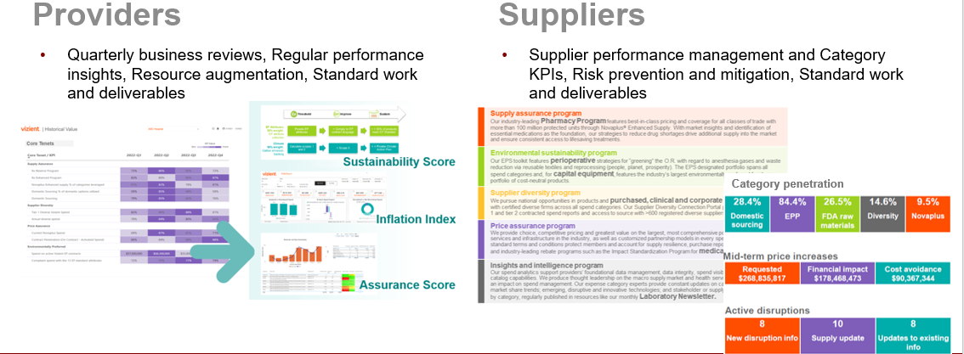
Excel
Informing UCM’s Supplier Scorecard process with data to drive new measures that impact Patient Outcomes & Experience
in Patient and Clinician Experience
Notes:
Simrit – walks through each pillar highlighting how Vizient supports UCM goals

Slide 60
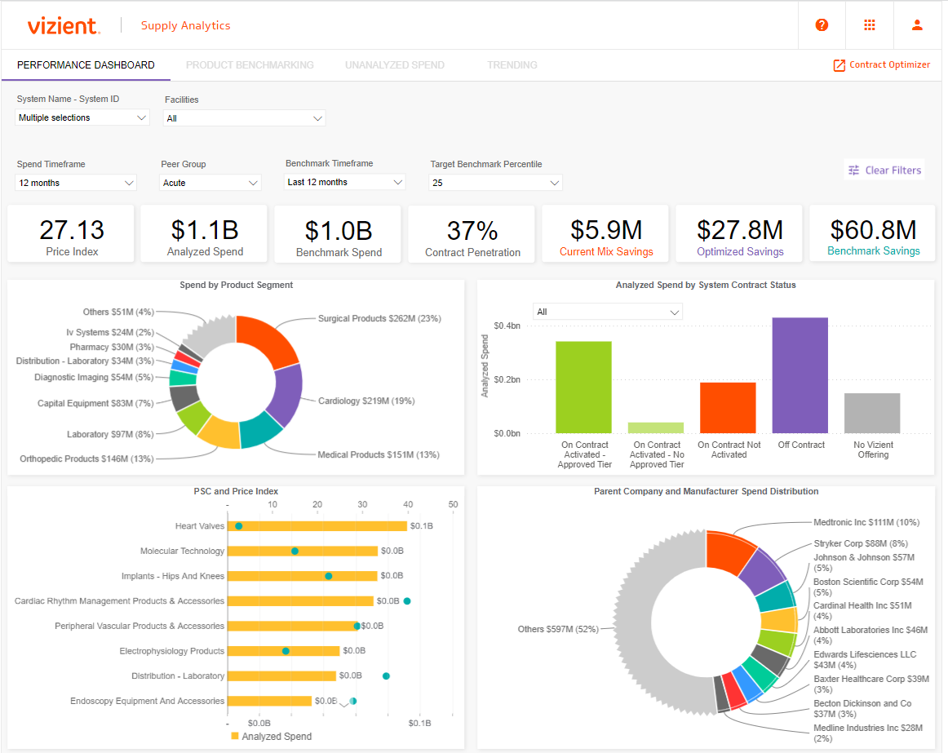
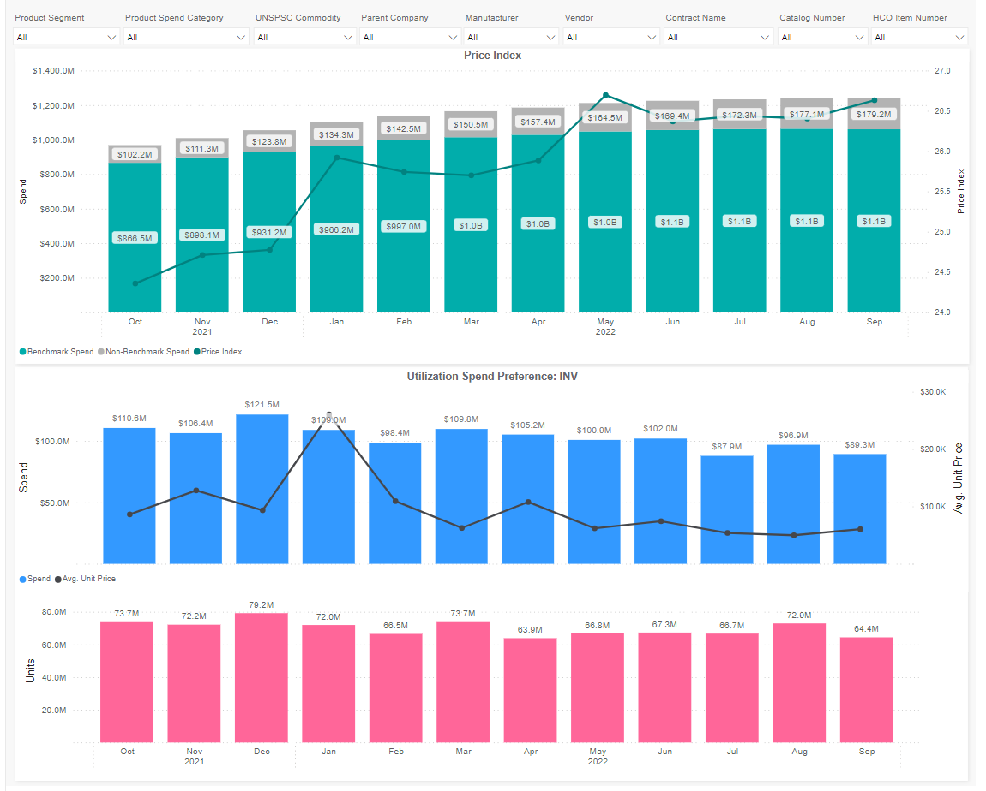
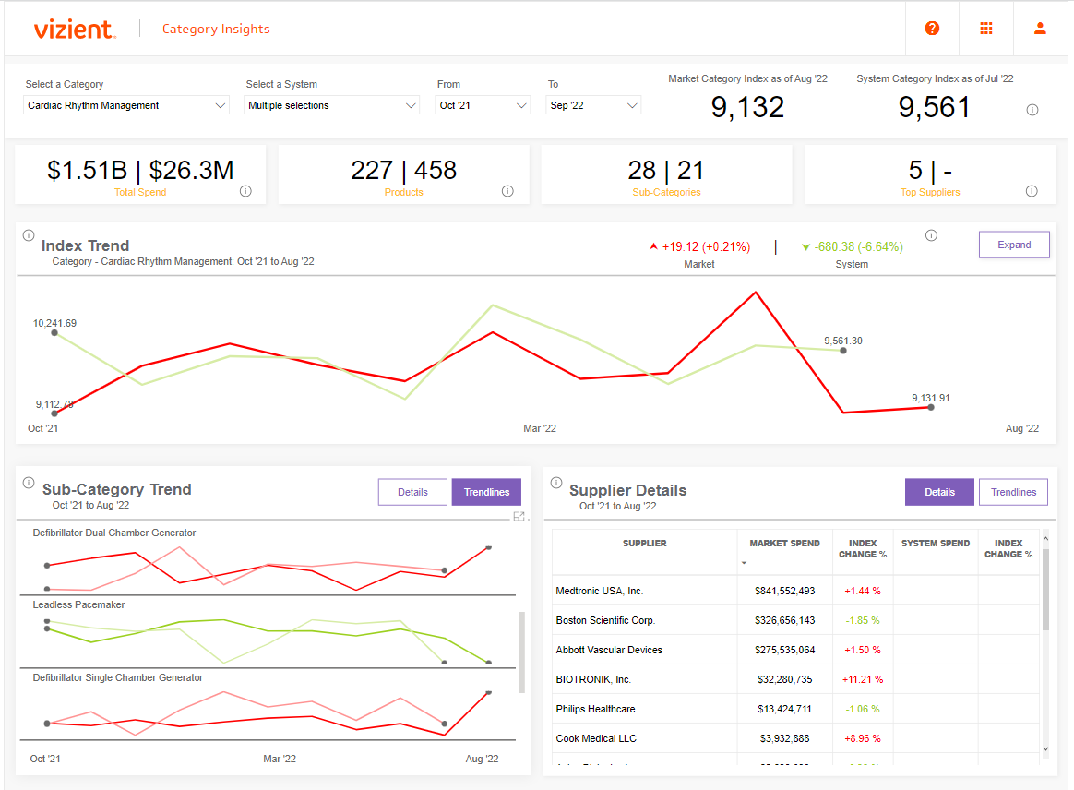
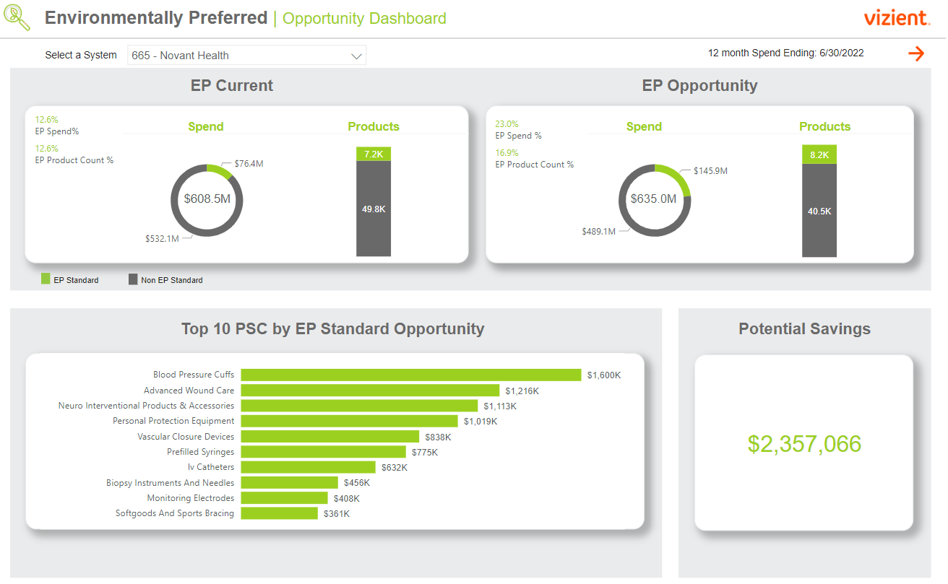
Fueled by a full suite of insights & intelligence
Deliver
High-quality, Cost-effective Care
Excel
in Patient and Clinician Experience
    Supply analytics
    Pharmacy analytics
    Category insights
    Purchased services analytics
    Contract catalog
    Vizient Clinical Data Base
    Procedural analytics
    Sg2 market analytics
    Clinical Practice Solutions Center®
Notes:
Simrit – walks through each pillar highlighting how Vizient supports UCM goals

Slide 61
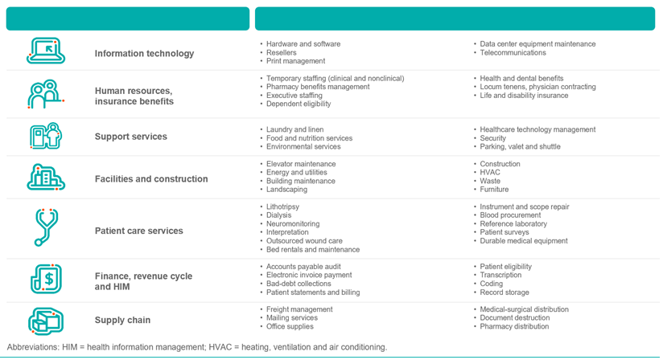
Focus on Indirect Spend & Standardization while investing in local communities
Expand
Our Health System Network
Notes:
Simrit – walks through each pillar highlighting how Vizient supports UCM goals

Slide 62
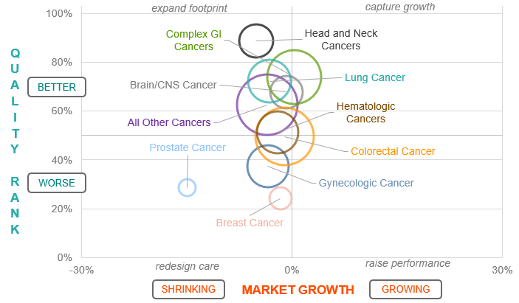
Partnering for Strategic Service Line Growth
Grow
Signature Specialty Programs
Collaborative approach with use of multiple Vizient tools to provide insights.
Ability to review insights from Sg2 market analytics, Clinical Data Base (CDB) and Clinical Practice Solutions Center (CPSC)
Market growth forecasting data and to determine which sub-service lines with the largest opportunity for growth.
Review sub-service lines for access data via CPSC to ensure infrastructure and capabilities to support growth in the ambulatory setting
Use CDB to ensure strength of quality measures for these programs.
Notes:
Simrit – walks through each pillar highlighting how Vizient supports UCM goals

Slide 63
Enhance
Environmental Sustainability Dashboard
- Displays EPP compliance metrics across entire system
- Ability to view specific EP attributes
- Drillable to facility, PSC, product segments and more
Vizient Vulnerability Index
- Aggregates 43 social determinants of health data points into nine categories at the local, regional and national levels that impact health outcomes.
Supplier Diversity – Community Contracting
- Facilitates reinvesting in the local economy using the power of purchasing within healthcare systems by directing spend to local, diverse suppliers who in turn hire from the community providing livable wages, insurance, and career paths.
- By engaging all hospitals in a region as well as large suppliers, who through Community Contracting Program contract with local, diverse suppliers, creates a socially and economically sustainable ecosystem resulting in healthier populations.
the Health of Our Local Community
Vizient Vulnerability Index
Community
Contracting
Notes:
Simrit – covers then hands back to Eric

Slide 64



Data is the currency of performance improvement
Unprecedented Challenges
Financials are unsustainable
Increasing regulatory pressures
Lack of information exchange is a key contributor
Expanding Line
of Sight
Unified data is needed across providers and suppliers to:
Measure performance
Identify opportunities
Activate Impact Purchasing strategies
Building a Data Exchange
We need commitment to submit complete and accurate data from both providers and suppliers
We need “a coalition of
the willing” to build the data infrastructure necessary for spend management
Notes:
Eric thanks Simrit and covers the Supplier ask for data and transparency in partnership with Vizient

Slide 65
Denise Scarpelli
VP & Chief Pharmacy Officer
Notes:
Invites Denise on Stage

Slide 66
Dominant Trends and Forecasts for 2023-2024
Drug shortages- Cisplatin and Carboplatin- > 200 drugs on shortage list
Increase in Medicare Advantage Plans- at-risk contracts
New PSAOs to increase access to Specialty Payer Networks i.e. Accelerate
Increase need for digital health, devices, and diagnostics to allow for virtual visits
Ambulatory Pharmacy focus on Population Health- value-based treatment
Growth in home delivery, Specialty, and Infusion
Growth in cell & gene therapies in the pipeline- Sickle Cell and Hemophilia
Specialty drugs now account for 51% of the Pharmacy Market
Many biologics facing loss of exclusivity in 2023 and 2024
Surge in GLP1’s usage for Diabetes and Weight Loss
COVID vaccine moving to commercial market this fall

Slide 67
Pharmacy Challenges
Staffing shortages
Drug Shortages
Payers shifting patients to lower sites of care or mandating white/clearing bagging
Payer access for Home Infusion
340B challenges with manufacturers creating restrictions around contract Pharmacy
Drug prices increasing
Pharmacy deserts
Impact of the Inflation Reduction Act – Medicare negotiating drug prices

Slide 68
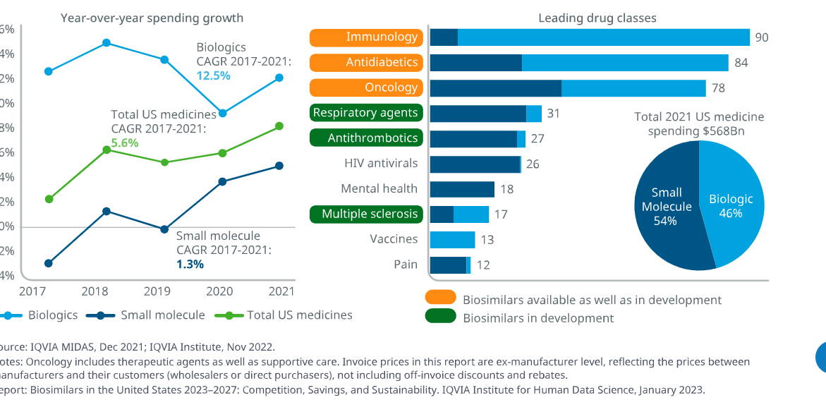
US Biologic Growth Outpacing Non-Biologics
Growing faster than non-biologics
Compromises 46% of spending
3 areas with the highest spending- immunology, antidiabetics, and oncology (account for 70% of spend)

Slide 69
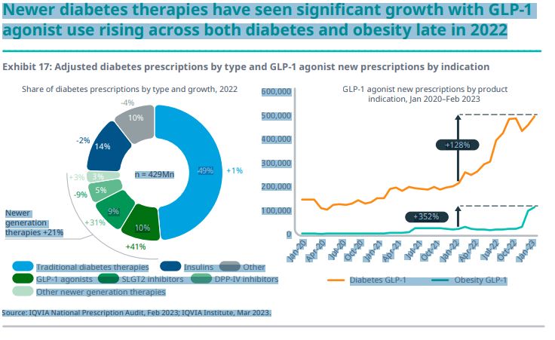
Newer Diabetes Therapies Significant Growth- GLP-1

Slide 70
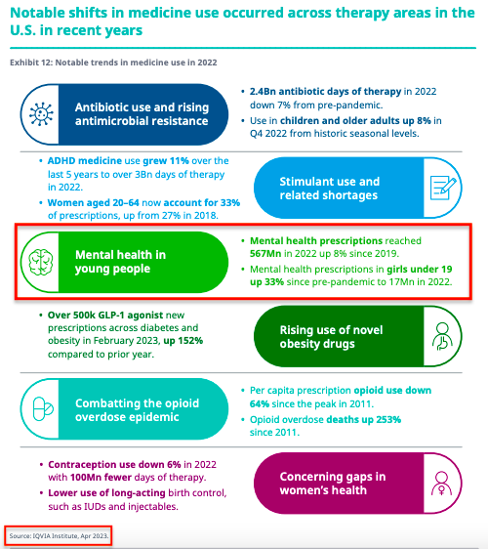
Trends in Medication Use

Slide 71
UCMC Inpatient Drug Cost / IP Admissions and Observations
The team focused on reducing drug spend on inpatient i.e. Vial-to-bag launch

Slide 72
UCMC Outpatient Drug Cost / Script

Slide 73
340B Impact Statement
UCMC has been able to expand outpatient care programs because of the 340B program.
Examples of services include:
  Promoting Patient Medication Access by Expanding the Meds2Beds Program and Creating an Emergency Department Outpatient Pharmacy
  Improving Patient Outcomes by Reinforcing our Ambulatory Care Clinics with More Ambulatory Pharmacists
  Providing access to high-cost medications by offering discounted prices

Slide 74
Pharmacy Department Plans FY 2024

Slide 75
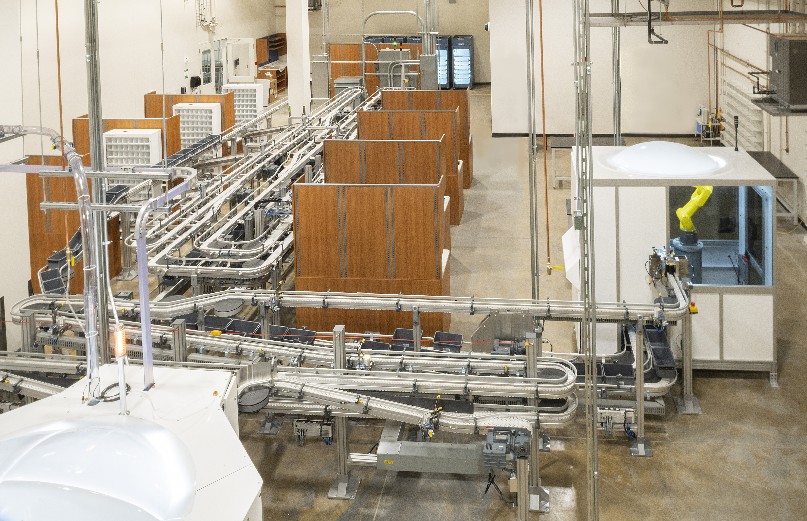
FY23 Pharmacy Accomplishments
Achieved ASHP COE designation
Opened new central fill facility this past April
Hospital @ Home
New Technician Learner Program
Growth of Home Infusion
Partnership with Advent Health
Pharmacy fully Integrated with Ingalls

Slide 76
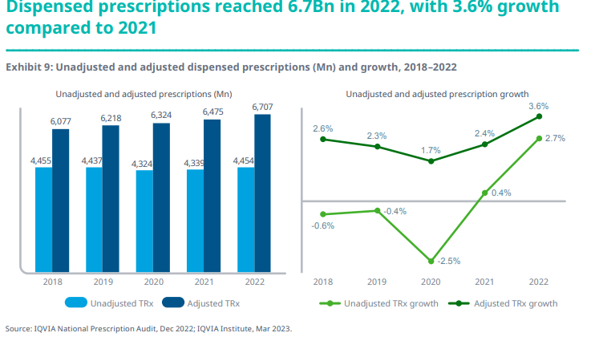
Dispensed Prescriptions Grew by 3.6% in 2022

Slide 77
Outpatient Script Count- Growth Due to Mail Order

Slide 78
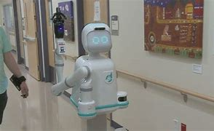
Key Pharmacy Strategies for FY24
Expansion into Northwest Indiana
Roll-out of Omnicells to Ingalls
Pilot of Moxi Robots
New high Speed packager for inpatient
Growth of outpatient scripts- mail order and central fill
Expansion of Infusion services
Hiring and Retention strategies

Slide 79
Biosimilar Pipeline

Slide 80
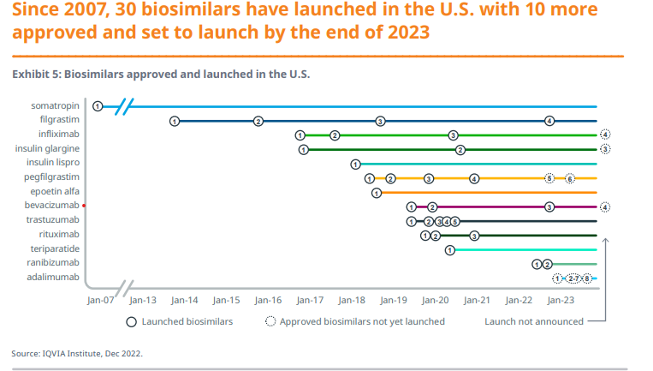
Biosimilar Launched in US

Slide 81
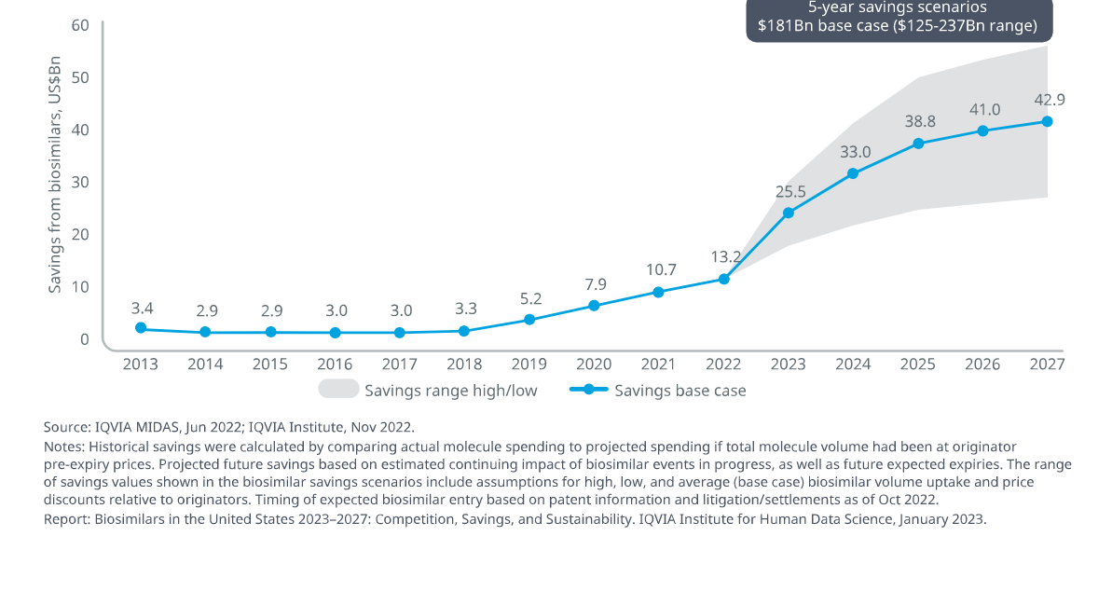
Biosimilar 5-year Savings

Slide 82
Summary
Staffing challenges continue throughout the healthcare
New biosimilars coming to market, with slow adoption
Outpatient script growth with more patients shifting to mail order
Home Infusion potential with national home infusion companies leaving the acute business and increase in injectable specialty medications
Continue growth in Specialty Pharmacy with the new drugs hitting the market- oncology and neurology
Drug shortages will be a challenge
Value-based care top priority for health plans
340B Contract Pharmacy Business will be a challenge

Slide 83
References
Biosimilars in the United States 2023-2027. IQVIA. https://www.iqvia.com/-/media/iqvia/pdfs/institute-reports/biosimilars-in-the-united-states-2023-2027/iqvia-institute-biosimilars-in-the-united-states-2023-usl-orb3393.pdf Published January 2023.
The Use of Medications in the US 2023. IQVIA. https: The Use of Medicines in the U.S. 2023 – IQVIA. Published May 2, 2023.

Slide 84
Ian O’Malley
Exec Director of Strategic Sourcing

Slide 85

1
01
Strategic Sourcing Overview
2
02
Value Analysis & Category Management
3
03
Building Resiliency
4
04
Contracting & Surgery Exchange

Slide 86
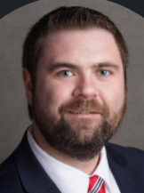
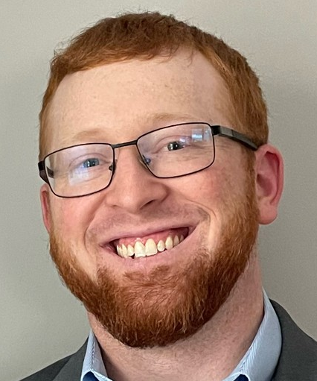









Ian O’Malley
Executive Director, Strategic Sourcing
John Mayer
Asst. Director, Strategic Sourcing
Cara Eason
Jordan Schleyer
Christina Villareal
Tim Garrett
Brooke Lenderink
Strategic Sourcing Category Leader-Women’s & Childrens, Ambulatory
Strategic Sourcing Manager-Heart & Vascular, Digestive Diseases, Anesthesia
Construction Equipment Sourcing Manager-Radiology, Rad Onc
Strategic Sourcing Manager-Perioperative Services
Strategic Sourcing Manager-PCS, Lab, Pharmacy
Peter Brewster
Alan Holmgren
Strategic Sourcing Category Leader
Adrian Skryzek -Strategic Sourcing Category Leader
Abigail Kinzel
Strategic Sourcing Category Leader
Strategic Sourcing Category Leader-Ingalls Memorial

Slide 87
Strategic Sourcing Overview
Strategic Sourcing is an organized and collaborative approach to leveraging targeted spend across a system with select suppliers that are best suited to optimize value for our patients and our organization.
Supplier Relationship Management
Category & Contract Management
Vendormate (GHX); Supplier Scorecarding
GHX, Oracle, Scout, Vizient, iValua, Surgery Exchange, Primrose, Valify
Value Analysis
Capital Equipment
Procedural Analytics, ECRI HTAIS, VAT Meetings
ECRI, Trimedx

Slide 88
1
01
Strategic Sourcing Overview
2
02
Value Analysis & Category Management
3
03
Building Resiliency
4
04
Contracting & Surgery Exchange

Slide 89





Driving Out Costs – Value Analysis

Slide 90

Value Analysis– Procedural Analytics
Benchmark procedural costs across Vizient nationally
Includes quality metrics
Developing plan to implement at Ingalls main campus, Same Day Surgery and Northwest Indiana once opened.

Slide 91

Category Management-Sourcing Roadmap
01
Gather data
02
Internal stakeholder alignment
03
Go to market approach and strategy
05
RFI/RFP development and/or contract negotiations
06
Supplier selection and implementation plan
07
Implement & Monitor

Slide 92
Category Management-Off Cycle Projects
While we maintain a bid calendar tied to contract timelines there are many scenarios where a category may require off cycle assessment
Inflationary pressures are increasing this cadence and price increases are becoming the primary initiation for projects off cycle along with supplier performance due to disruption
01
02
03
04
Initiation
Planning
Execution
Control
Price Increase
Tech Change
Benchmark Alignment
New Service/Surgeon
Supplier Performance
VAT Review
Clinical Champion
Market Assessment
Bid/No Bid
Establish Timeline
Communicate to Market
Supplier Performance Data
Issue RFP
Negotiate Contract
Coordinate Trials
Clinician Support
Award Contract
Systems Updates
Operational Updates
Monitor Performance
Track qualitative data if available
VAT Updates

Slide 93
Capital Equipment Sourcing
Routine
140 Projects $38.2m
Strategic/Contingency
Est. $2m
Construction/New Site Support
$22m
Understand Stakeholder Need and Define Specs
System Standardization Assessment
Bid/RFQ
Negotiations
Legal Terms, IT review, Privacy Review, Service Coverage Post Warranty
Execute agreement
Coordinate delivery, training and implementation

Slide 94
1
01
Strategic Sourcing Overview
2
Value Analysis & Category Management
02
3
03
Building Resiliency
4
04
Contracting & Surgery Exchange

Slide 95
Building Resiliency: Supplier Expectations
1
Transparency
Our supplier representatives need to be prepared to answer and provide documentation on product/device origin
2
Proactive Communication
Sales needs direct lines of communication with their Operations teams and provide data with alternative options before disruption hits our shelves
Supply Chain Resilience
3
Suppliers need to invest in their resiliency plans. Diversify sites of production, invest in near/onshore capabilities, expand inventory positions and don’t outsell your operational capability. Work with our distributor (Cardinal) on communications and inventory.
Built in Resilience
4
We are partnering with Vizient on a Supply Risk Solutions tool. Suppliers need to be able to partner with Vizient in providing manufacturing data
Resiliency Tools

Slide 96
1
01
Strategic Sourcing Overview
2
Value Analysis & Category Management
02
3
03
Building Resiliency
4
Contracting & Surgery Exchange
04

Slide 97

Medical Device & Equipment IT Contracting
The MDS2 is intended to be used as part of the security procurement process. The MDS2 clarifies roles and responsibilities of manufacturers and healthcare delivery organizations for the upkeep and maintenance of a connected device security posture. The form is manufacturer-completed and provided to healthcare delivery organizations upon request
PHI Determination and BAA need
Software & Security (MDS2 Form)
Systems Connectivity Requirements
  Epic, PACS, WiFi
Medical Device Connectivity Market

Slide 98

Surgery Exchange
Platform to manage the Bill Only Process
  Expedite payment cycle
  Ensure pricing accuracy by using contract price validation
Supplier Awareness
Implants not on contract will have delayed payment
Reps need to be aware of what is on contract. You are responsible for ensuring pricing is agreed to before product is brought on site.

Slide 99

Finally-Thank You To Our Supplier Partners

Slide 100
Robbie Brown
Director of Strategic Sourcing, Non-Clinical

Slide 101





Non-Clinical Sourcing Team
Robbie Brown
Director, Strategic Sourcing Non-Clinical
Allison Ross
Sourcing Category Leader
HR
Marketing
Supply Chain
Print Services
Lara Rodrigues Christmann
Sourcing Category Leader
Revenue Cycle
Clinical IT System
Deona Hasimllari
Sourcing Category Leader
Support Services
Facilities
IT Staffing
Melissa Maximoff
Sourcing Analyst

Slide 102
Value Analysis Teams/ Departments
Supply Chain
Marketing
Human Resources
Finance
Revenue Cycle
IT Infrastructure/ Hardware
IT – Business Applications
IT – Clinical Applications
Health Information Management
Print Services
Facilities
Environmental Services & Patient Transportation
Food Services
International Department
Business Development & Strategy

Slide 103






FY24 Priorities – Continue Supporting Vision of One UCM
Margin Improvement – Continue to execute strategies that reduce non-labor expenses to help support our system growth
Supporting Implementation of Enterprise Systems – Implementation of single instance of key enterprise systems will enable the system to drive operational efficiencies
Continued Enablement of Shared Services Expansion of shared services and best practices allow the system to provide a consistent experience for patients and staff

Slide 104

Purchased Service Contracts
In January 2023, we implemented a new process to Purchased Service Spend Management to balance expenses while providing the highest quality of care to our patients. This approach focuses to ensure resources are available for organization priorities:
Requester submits PSC form
Department
VP Approval
Y
Supply Chain
VP Approval
Y
Finance VP Approval
Y
Contract Approved
N
N
N
Operating Expense Contracts
230 Contracts Submitted/ Reviewed in first 6 months
83 requesters submitted contracts

Slide 105
Non-Clinical Key Projects
Completed FY23
In-Flight Initiatives FY24
Identified Initiatives
Pharmacy Benefits RFP
Records Retention RFP
EVS Supplies RFP
Regulated Medical Waste RFP
Statement Printing (eStatements)
Executive Search RFP
Telecom Audit
Medical Coding RFP
Contingent Labor
Managed Print Services
Ambulatory Housekeeping
Mobile Phone Audit
Benefit Administration
Elevator Maintenance
Food Services - Floor Stock
Landscape & Snow Removal
Multi-Media Services
Energy Utilization
Soap, Sanitizer & Towel Standardization
Kitchen Equipment Maintenance
Key FY23 Accomplishments:
Staffing and Application Contracting for Epic and Oracle Implementation
Pharmacy Benefits RFP & Contract
Food Service Management Contract Conversion

Slide 106

FY24 Margin Improvement Support
Review of Payment Term Strategies
UChicago Medicine Payment Options
Contingent Labor
Capture and improve contingent labor productivity reporting to maintain accurate timekeeping records.
Define a process to review and approve new contingent labor requests and rates.

Slide 107



Supporting our FY24 Priorities
Supporting Implementation of Enterprise Systems
  Working with Supplier to improve and streamline transactions
  Compliance to Security and Privacy Standards
  Support sunsetting of applications – data retrieval and potential access
Continued Enablement of Shared Services
  Working with our Enterprise Partners
  Compliance to Master Agreement Terms
Margin Improvement
  Supporting Operational Expense Reduction Targets (5-7%)
  Payables (Virtual Card Program Participation, Electronic Payments)

Slide 108



Supplier Registration & Contracting System
Supplier Registrations moved from iValua to Oracle Cloud in October 2022
  Electronic documents (supplier certification & conflict of interest)
Partnering with iValua to further enhance our Contract Management tool to improve the contracting review process
  Improved Team chat functionality
  Seeking to implement dynamic contract review workflows

Slide 109



Supply Chain Affiliate Program
AdventHealth’s Great Lakes Region: Bolingbrook, Glendale Heights, Hinsdale and La Grange hospitals along with a network of nearly 50 locations in western suburbs
Advent Health contract portfolio in place
Expectation is that all of our supplier partners are providing a similar level of support to our affiliate partners that UCM is receiving

Slide 110
Joan Archie
Executive Director
Business Diversity & Compliance

Slide 111
Why Business Diversity at UCM
• We Value unique perspectives and creative solutions
• We want a competitive edge in the marketplace
• We want to mitigate risk
• Economic Impact
• Strengthened local economies

Slide 112
Components of Business Diversity at UCM
Business Diversity:
Last fiscal year over $28 Million in contracts awarded and paid to minority and woman owned non construction firms
Over $150 Million was awarded and paid to firms with offices in the State of Illinois.
Construction Diversity:
Last reported fiscal year over $14 Million awarded and paid to certified minority and woman owned firms providing service on UCM construction projects
Over $1.3 Million dollars in wages paid to minority and female workers on these projects.

Slide 113
Current Major Initiatives

Slide 114



UChicago Medicine – Crown Point, IN

Slide 115
Northwest Indiana – Community Vendor Fair
UChicago Medicine has a strong desire to engage with local firms.
We believe this contributes to the growth of the region and fosters economic development.
To achieve our desire to connect with local firms we are hosting a vendor fair in September. We are looking for firms that can provide specific services needed to support building operations based in the local community. These services include:
Ambulance Services
Catering/Food Services
Fire Alarm Services
Floor mat rentals
HVAC/Mechanical, Electrical, Plumbing
Lawn Care & Landscaping, Flower Bed Care
Linen Services
Medical Facility Cleaning Services
Messenger/Courier Services
Pest Control
Sharps Removal Services
Snow Removal
Parking Lot Sweeping
Parking/Valet Services
Promotional Materials
Trash and Recycling Services
Window Washing

Slide 116



UChicago Medicine – Hyde Park Cancer Center

Slide 117
UChicago Medicine – Hyde Park Cancer Center
Constructed to address longstanding disparities in care delivery and cancer outcomes.
Guiding Principals:
  Provide a facility devoted to cancer research , prevention, detection, treatment and survival
  Offer access to new diagnostic and treatment innovations in cancer
  Address health inequities with a two-pronged approach to support a healthcare ecosystem for the South Side
  Ensure South Side patients have the same access to healthcare as other communities in the City
  The Cancer Pavilion is in the design phase with construction starting near the end of 2023 and continue through the end of 2027
  Construction activity is concentrated on the medical campus, bounded by East 56th and East 57th Streets and South Maryland and South Drexel Avenues
In keeping with our economic development and diversity goals, at least 41% of construction contract dollars will go to minority- and woman-owned businesses.
  There are also on-site labor goals designed to increase economic benefit to minority and female construction workers.
  On-site workforce residency goal is 40%, with emphasis on the surrounding eight (8) ZIP codes.
  Workforce diversity goals include 30% minority and 5% women journey workers and apprentices, and 40% minority and 5% women laborers. (Based on hours generated.)

Slide 118
Diverse Supplier of the Year

Slide 119

Diverse Supplier of the Year
R4 Services

Slide 120
Atanas Ilchev
System Director Supply Chain Operations

Slide 121

Continued Expansion
Glenview Uro/Gyne
Central Fill Pharmacy Calumet City
Cal City Oncology
River East Urgent Care
River East Imaging Center
Dearborn Station Urgent Care
Homewood Urgent Care
Orland Park 4th Procedures Floor Expansion

Slide 122


New Technologies - Moxi
Lab samples
Pharmacy deliveries
Discharge medications
Infusion/Chemo
Telemetry
Lightweight equipment
Supplies
OR lab samples/blood bank

Slide 123
New Technologies – Moxi Video
Link to Movie
Notes:
1min 32sec

Slide 124

New Technologies - eLabel
Next generation product information system
      Battery powered, Wi Fi enabled, programmable, high visibility multicolor electronic labels affixed to shelves and bins to display critical product information
      Full ERP integration for automatic item updates (i.e., product substitutes, item conversions, mfr. item number changes, par level adjustments, etc.)
      Multifunction, durable device with scratch resistant anti-glare coating and 5 to 7-year battery life
      Two programmable multifunction buttons increase flexibility
      “Paper-like” 180° viewing angle with matte and anti-glare finish

Slide 125


New Technologies – alEx Machine
alEx Machine is a linen dispensing solution providing controlled access for authorized users only, analytics on linen usage and visibility into linen inventory.

Slide 126

New Technologies – Smart Locker
Indoor smart lockers offer a simple, robust solution for a variety of applications.
Whether you’re looking to streamline deliveries at a corporate mailroom, manage mail for multifamily residents, or provide contactless order pickups for customers, smart lockers provide a simple, secure, and easy-to-use solution.

Slide 127











Cardinal Health + UCM Health
UCM Health Non-Acute
UCM Health Acute

Slide 128
Grace Sperr
Lead Business System Analyst
Nancy Olmos
Assistant Director Purchasing

Slide 129









Supply Chain Business Process Team
Anurag (AJ) Jaiswal
Executive Director, Supply Chain Systems & Analytics
Hussam Bachour
Manager, Supply Chain Systems
Grace Sperr
Lead Business Systems Analyst
Maria Hernandez Velastegui
Business Systems Analyst, Senior
Dhaneesh Sharma
Business Systems Analyst, Intermediate
Tierra Goldston
Supply Chain Analyst
Anurag Makhloga
Business Systems Analyst, Senior
Jasmine Smith
Supply Chain Analyst
Grishma Dangol
Business Systems Analyst, Intermediate

Slide 130






FY22-23 Supply Chain System Priorities
✓
✓
Ingalls One Epic Implementation
SOAR Implementation
FY22 – FY23
Ingalls Supply Chain Transformation
✓
Bill Only Process Improvement
✓
Notes:
Grace
What was planned for FY 22-23, what we achieved

Slide 131



Project SOAR Impact to Procure-to-Pay
Notes:
Grace
Drill down to SOAR Project completion in July for Ingalls. Impact across the healthcare system and across our entire P2P process

Slide 132

Project SOAR Primary Benefits
Notes:
Grace
For all those impacted areas, working toward One UCM, Innovative solutions, Improved User Experience

Slide 133

Supply Chain Systems and Data Transformation
One ERP System for end users and suppliers
Consolidated Supplier Records, Item Catalog, and Location Management
One GHX EDI profile
Bill-Only / Bill-and-Replace Order Communication
Supplier Portal Access for onboarding
Contract – ERP Price Alignment
Standard Procure-to-Pay workflow for the health system, including PHA, Care Network, Ingalls
Notes:
Grace
Remove “information updates” for portal

Slide 134
FY24-25 Supply Chain System Priorities
NWI Go Live
EPIC Supply Documentation Improvement
FY24 – FY25
Investing in Supply
Chain Resilience
AI / Automation for SCM Processes
ERP Stabilization
Notes:
Grace
Highlight projects for Backorder management, forecasting, backorder visibility, ask them to share backorder data

Slide 135









Supply Chain Purchasing Team
Anurag (AJ) Jaiswal
Executive Director, Supply Chain Systems & Analytics
Nancy Olmos
Assistant Director, Purchasing
Mike Lively
Supervisor, Purchasing
Sherry Liesse
IMH Manager
Alberto Rocha
Supply Chain Analyst
Keith Kissinger
Specialty Buyer
Michelle Cox
Specialty Buyer
Byron Ealy
Purchasing Agent
Edward Anderson
Specialty Buyer
Mark Lukasick
Specialty Buyer

Slide 136

UCM Procure to Pay Transformation
Standardized procure to pay processes across UChicago Medicine
Introduce demand management protocols
  Establish optimal P2P tools/solutions
Annualized Purchased Service PO’s
  Legacy PO to Cloud PO transition
  Recurring Invoices opportunity
PO Price Change Approval Workflow
  Contract price accuracy
UChicago Medicine Payment Options
Notes:
Nancy
Leaders with responsibilities across legal entities have a single view for annual planning for their entire organization
Office Depot, Taylor, Fed-Ex Punch-out (no site-based orders)
A modern financial architecture, with a robust Chart of Accounts, aligned with the University, UCMC, and CHHD/Ingalls
Expanded auto receiving integrations, offsite locations, Bill Only, Substitutes, etc
Real time resolution of price exceptions, PO updates, and spend analysis impact
Bill Only & Bill and replace ( communicate PO’s to suppliers)
electronic payments to replace paper checks. Preferred payment methods include Card and Automated Clearing House, (ACH).
Administrative Efficiency: Annual POs reduce paperwork, administrative burden, and the need for repeated documentation for recurring service orders
ACH payments provide automated processing for recurring transactions

Slide 137
How can our supplier partners help?
  EDI is our preferred method of transacting end-to-end:
    850 PO Communication, 855 PO acknowledgment, 856 Shipment Notification, 810 Invoice
    Non-EDI suppliers: PO confirmation should be emailed to UCH_PURCH@uchicagomedicine.org
    PO-based invoices: UCM: accounts@uchicagomedicine.org & CHHD accountspayable@uchicagomedicine.org
  Accurate and complete invoicing:
    A UCH issued PO number is required to ensure there are no process exceptions for invoice payments,
    this reduces discrepancies and payment delays
  Communicate organizational changes proactively. i.e. mergers, price changes, etc.
  Credit Hold Mitigation: Disputes communicated proactively to mitigate credit holds (Monthly statement reviews)
    Promptly address and resolve issues to maintain trust and prevent delays in payments
  Backorder mitigation: Impact to operations, lines of business, P2P, and most importantly patient care
  Accurate Data
    GTIN Information will enable future scanning solutions and improvements
    Price sharing to reduce discrepancies
Notes:
Nancy
EDI Preferred
> Continue to support new location adds as we continue to grow
Backorder mitigation. Impact to operations, lines of business, and patient.
Forecasting, PO revisions, receiving against original order, inventory tracking, Invoicing, Payment delays, patient impact
Dispute Resolution Management

Slide 138

How can our supplier partners help?
  How do your top customers transact (Ties back to challenges and demand management)?
    Our challenges are not unique and we want to hear from you
  How are we currently ordering from you?
    Do you receive our PO’s?
    Do you transact via EDI?
    How are we currently paying you?
    Do you accept Card or ACH?
    Please complete our Survey to engage further: UChicago Medicine Supplier P2P Survey (smartsheet.com)
Thank You!!
Notes:
Nancy
EDI Preferred
> Continue to support new location adds as we continue to grow
Backorder mitigation. Impact to operations, lines of business, and patient.
Forecasting, PO revisions, receiving against original order, inventory tracking, Invoicing, Payment delays, patient impact
Dispute Resolution Management

Slide 139
Supply Chain Leadership
Q&A

Slide 140
Closing

Slide 141
This is a challenging time…but our core principles remain…
Quality – zero defects
Cost – best in market
Delivery – 100% on-time & complete
Technology – At The Forefront
Service – best in class

Slide 142
Thank You

